Slide 1
Train the Trainer
Day 1: Preventing Youth Radicalisation
Notes:
Instructions/suggested text sheet 0
Welcome to the training, introduce yourself (check if attendance list is signed by all participants)
Shortly mention the context and main goal of the TTT.
Part of project ARMOUR. It is sponsored by the EU and aims to reduce radicalisation among youths. To achieve this, partners from 6 countries work together to create support for first line practitioners who work with children from 10-18 years of age.
@Trainer: This TTT is meant for first line practitioners who will are interested in the prevention of radicalisation. The TTT has 3 overlapping objectives:
To get acquainted with the TTT in order to be able to give the training themselves (cascading of TTT)
To be introduced to the 7 workshops to be able to give the workshops
Getting to know about radicalisation and causal factors and experience examples of exercises to influence these causal factors
@Trainer (see manual for further instructions)
Needed
Attendance list
Laptop/PC and beamer
Pens and paper for participants
Flip over
markers, cards, white paper sheets, scissors, smartphones to access Pauliseverywhere
internet access,
Hand-out exercise(s)
Suggested planning session 1
Walk-in, coffee, tea 15 min
Introduction 45-50 min
Explanation radicalisation 30-45 min (depending on initial knowledge, this can be extended or shortened)
Break 15 min
Coaching and parenting 25 min
Exercise(s) 60 min
Lunch 60 min (take time for exchange of experiences and building network if possible)
Critical thinking 30 min
Exercise 1 30 min
Break 15 min
Exercise 2 45 min
Feedback and conclusion 15-20 min
Usually, things take more time because of questions and interaction so take about 6-7 hours. Depending on the number of participants, their level of knowledge at the start and the amount of discussion, the amount and choice of exercises, the estimated time of the first session can vary. One could start at 09.00 AM and plan to end at 16.00 PM.
For practical reasons the execution of the program can be shortened or distributed over more days.
If the training is executed online, you could consider sending the factual information on the workshops and on the general concept of radicalisation to the participants before the training so the content of the online sessions will be focussed on the workshop topics and the accompanying exercises. The downside of this is that there will be less content on radicalisation in the actual meeting.

Slide 2
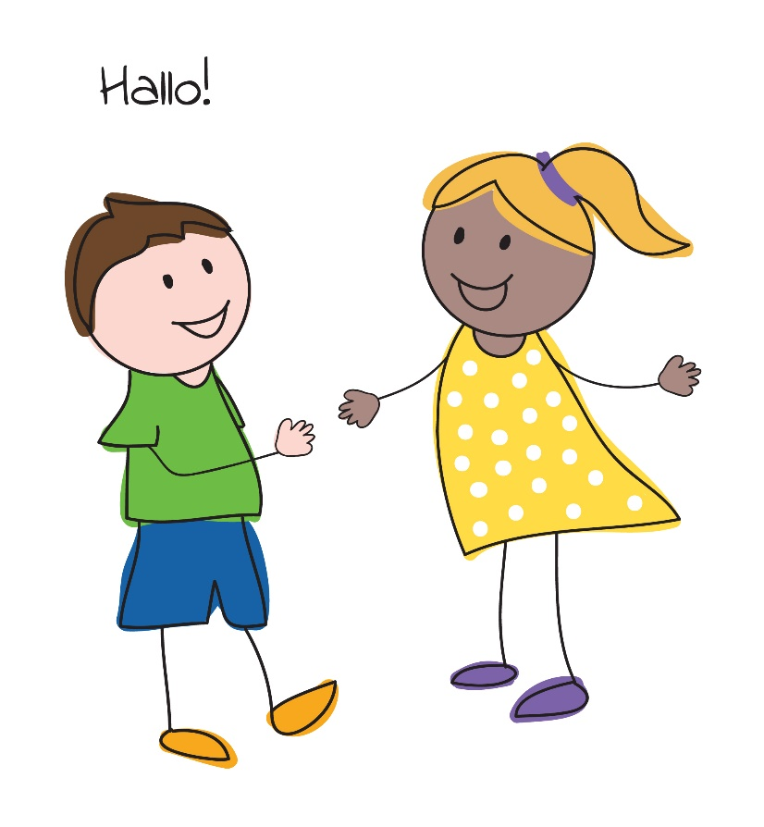
Hello!
Source: LIBRe Foundation
Notes:
Instructions/text sheet 1
Before we dive into the content, I would like to start with introducing ourselves.
@Trainer:
Ask if participants will introduce themselves shortly (job, experiences with radicalisation, reason to participate, ..)
and if they would also indicate what they would like to take away from this training, when will it be successful?
Let them know if their expectations will be fulfilled during the training
Goals of the TTT (if not already mentioned by the participants)
To acquire knowledge about the process of radicalisation and the role of 7 different factors in it.
To learn about tools and train some skills in dealing with these factors contributing to radicalising youths (in TTT as examples, in workshops more extensively)
To use your own expertise to learn from each other
To get acquainted with the workshops (a.k.a. Labs) of ARMOUR, understanding their set up, so they will be able to deliver this training (and the 7 separate workshops with specific topics) themselves
To become aware of best practices in the field of countering radicalisation in general (last day)
Also mention the online addition of the TTT which can be found at: www.traininghermes.eu
@Trainer:
Important to connect to people and make them feel at ease

Slide 3
Programme (Day 1)
Introduction
Radicalisation
Coaching and parenting
incl. Exercises
Critical thinking
incl. Exercises
Feedback
Conclusion
What to expect next?
Day 2 includes:
Anger management
Narratives and identity
Debating and simulation
Day 3 includes:
Conflict resolution
Proportionate state response
Best practices
Notes:
Instructions/text sheet 2
To reach these goals we have chosen the following set up
Day 1
Introduction – the context of this training
Radicalisation – the main topic is Radicalisation, lecture on the process of radicalisation
Coaching and Parenting – explanation on the way coaching and parenting can either increase of decrease the chances of radicalisation
Exercises – experiencing one or more of the exercises to improve coaching and parenting skills
Critical thinking – explanation on the way lack of critical thinking can increase the chances of radicalisation
Exercises – experiencing one or more of the exercises to improve critical thinking
Feedback – your feedback on today’s exercises. Very important, to improve the effectiveness of the training
Session 2
Anger – explanation of how anger can fuel radicalisation + exercises
Narratives – explanation on the way narratives can either increase the chances of radicalisation + exercises
Debating and simulation – explanation on how debate and simulation strategies can help fight against radicalization + exercises
Session 3
Conflict handling – explain how the inability to deal with conflictual situations can boost radicalisation + exercises
State response – explain how the way the government responds to situations can either increase or decrease radicalisation + exercises
Best practices to prevent radicalisation

Slide 4
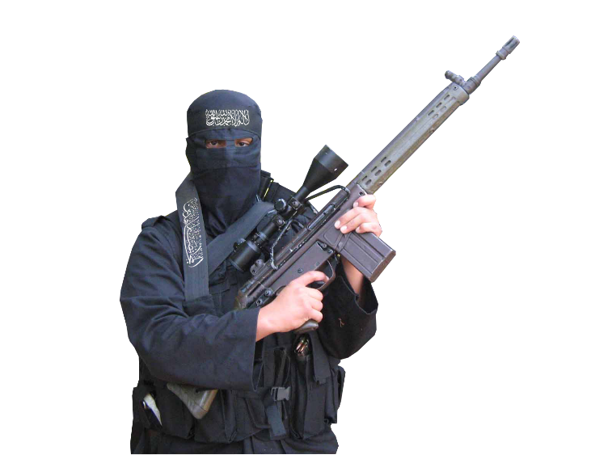
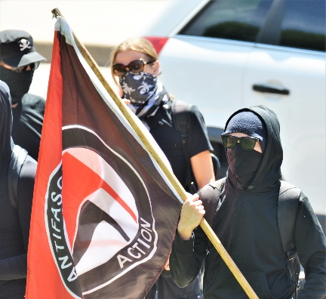
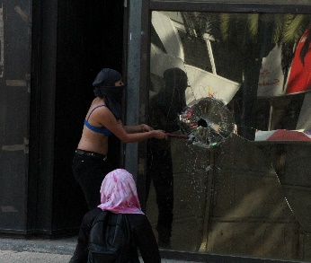
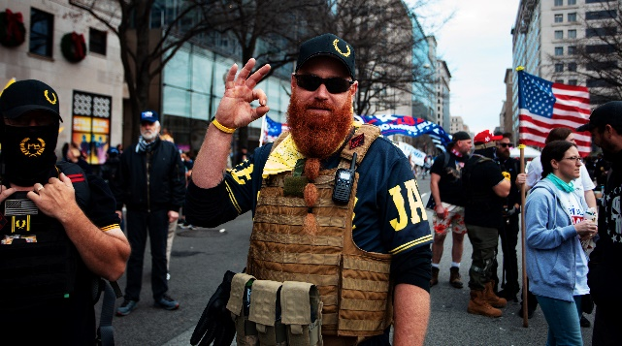
Introduction (1)
1
Why?
What strikes you?
How?
Right
Left
Religious
Single issue
Proud Boys in Washington, DC
Antifa
ISIS fighter
Feminist extremist
Source: www.shutterstock.com
Source: www.shutterstock.com
Source: www.hiclipart.com
Source: www.shutterstock.com
Notes:
Instructions/text sheet 3
Sources images:
https://www.shutterstock.com/nl/image-photo/washington-dc-usa-dec-12-2020-1873617571 (12 Dec 2020, Proud Boys in Washington)
https://www.shutterstock.com/nl/image-photo/denver-co-usa-june-10-2017-1472772446 Masked Antifa left-wing militants protesting at Trump rally Denver, CO, USA. June 10 2017.
https://www.hiclipart.com/free-transparent-background-png-clipart-ybpcm, Islamic extremist
https://www.shutterstock.com/nl/image-photo/mexico-city-03082020-woman-belonging-radical-1669444774 Mexico City, Mexico, 03/08/2020: woman belonging to a radical feminist group is seen destroying a glass window during the women’s day protest
Clip behind ‘Why?’
https://www.youtube.com/watch?v=NFrU9egvhbs (3.53m clip from FAST- Families against Stress and Trauma, about British young people who travelled to Syria, unexpected to their families)
Clip behind ‘How?’
https://www.youtube.com/watch?v=fVaFmcT7ssg (4.57m clip from the Canadian Centre for the prevention of radicalisation leading to violence, about a possible path to radicalisation).
One of the central questions people have asked is: Why do people become radicalised? How does it take shape?
Click + Ask participants to note what strikes them in these two clips:
Click on ‘Why?’
https://www.youtube.com/watch?v=NFrU9egvhbs (3.53m clip from FAST- Families against Stress and Trauma, about British young people who travelled to Syria, unexpected to their families)
Click on ‘How?’
https://www.youtube.com/watch?v=fVaFmcT7ssg (4.57m clip from the Canadian Centre for the prevention of radicalisation leading to violence, about a possible path to radicalisation).
Ask afterwards what they have noted (connect it later to the next slide)
@trainer:
To warm up the audience on the topic of radicalisation and to make them aware of the many ideologies and contributing factors
This exercise takes about 15-20 minutes

Slide 5
Introduction (2)
1
7 workshops
Individual capacity building
Coaching and parenting
Critical thinking
Community capacity building
State response
Anger management
Narratives and identity
Debating and simulation
Conflict management
Proportionate state response
Notes:
Instructions/text sheet 4
Many of the topics just mentioned in the two clips are being addressed in this course. These topics were chosen because the are relevant in the process of radicalisation. (as you just saw in the examples in the clips).
This was confirmed in interviews and focus groups with professionals. As a result 7 workshops were created and tested in experimental labs.
The first three working on individual skills (individual capacity building in the face of adverse conditions),
The second group are about empowering the surroundings of youths (community empowerment and resilience to social polarization, radicalization and violent extremism) and
The last workshop is about effective state response. (moderate and proportionate response of the governmental and security institutions against provocations and latent conflicts)
This course will show you information and examples of each of the 7 workshops. They are aimed at the internalisation and further replication of practical, hands-on strategies and personal skills of conflict resolution, peace building, critical thinking, anger management, proportionate response.
We will show you information and examples of exercises of each topic. The basic idea is that by following this TTT, you will be able to deliver each of the 7 workshops

Slide 6
Key competences
1
emotional
competence &
autonomy
building
social
competence
mediation &
negotiation
problem solving
Notes:
Instructions/text sheet 5
The workshops aim to equip first line practitioners with knowledge and tools to help youths become more resilient against radicalisation. Key competences to be strengthened in youths include:
social competence responsiveness to other, conceptual and intellectual flexibility, caring for others, good communication skills, sense of humour
emotional competence & autonomy building positive sense of independence, emerging feelings of efficacy, high self-esteem, impulse control, planning and goal setting, belief in the future
mediation and negotiation group problem solving and consensus, base groups, stop and think before acting to provocation
problem solving ability to apply abstract thinking, ability to engage in reflective thought, critical reasoning skills, ability to develop alternative solutions in frustrating situations

Slide 7
Workshops Set-up
1
Understanding radicalization in general
Relation between radicalisation and specific topic
Clarification specific topic
Exercises
Coaching and parenting
Critical thinking
Anger management
Narratives and identity
Simulation and discussion
Conflict management
Proportionate state response
Understand the topic
Identify problems
Solve problems
Notes:
Instructions/text sheet 6
The set up of each workshop is as follows:
The workshops offer information and exercises to come to:
a solid understanding of the concepts;
Roughly: radicalisation in general, the relationship between radicalisation and the workshop’s topic (one of 7 options)
Each workshop starts with a general explanation of the concept of radicalisation (just as we will do today), then it will be explained how e.g. the (in)ability to manage your anger will contribute to radicalisation.
the internalisation of skills, strategies and techniques to be used with youth. Practiced in the safe environment provided by the workshop.
The workshops propose techniques that help teach young individuals respond to dysfunctional situations that might trigger a radicalisation path. It equips professionals involved in interaction with young people with solutions to encourage them how to control behaviour by making choices that satisfy their needs in non-destructive ways and resolve conflicts in principled ways.
The exercises aim at different results, some teach you how to understand the topics, some to identify/map the problems and some help to solve the problem. Which is why you need to use them in combination for them to be more efficient and not as a one off.
Also, the hands-on strategies and skills taught within the workshops will address both risk factors and protective factors for radicalisation
Every workshop concludes with an evaluation. To improve the execution and make it more relevant.
@Trainer:
The design of monitoring and evaluation systems is fundamental to encourage in-depth thinking and ongoing reflection and ideally learning, about the overall design, approach and strategy of a programme, as well as its suitability to a certain context. Ris, L. and Ernstofer, A. (2017).
Address both risk factors and protective factors for radicalisation.
Every workshop concludes with an evaluation. To improve the execution and make it more relevant.
@Trainer:
The design of monitoring and evaluation systems is fundamental to encourage in-depth thinking and ongoing reflection and ideally learning, about the overall design, approach and strategy of a programme, as well as its suitability to a certain context. Ris, L. and Ernstofer, A. (2017).

Slide 8
Radicalisation
2
“a phased and complex process in which an individual or a group embraces a radical ideology or belief that accepts, uses or condones violence [ ] to reach a specific political or ideological purpose.”
Source: European Commission
Notes:
Instructions/text sheet 7
Moving to the second part of today’s programme we will now turn to radicalisation. What is it?
Many definitions of radicalisation exist, this is the one used by the
European Commission (2020). Prevention of Radicalisation. Retrieved 27 May 2020 from https://ec.europa.eu/home-affairs/what-we-do/policies/crisis-and-terrorism/radicalisation_en

Slide 9
Concepts
2
Activism
Extremism
Terrorism
Violent extremism
Climate of polarisation
Source: NCTV
Notes:
Instructions/text sheet 8
Starting with describing how radicalistion looks on the outside.
Some labels which are often used interchangebly are activism, extremism and terrorism.
In twos: think of an example of each of them.
@Trainer: Background
Activism, extremism, violent extremism and terrorism
(Ultra)right-wing or (ultra)left-wing parties or organizations that operate within the framework of the democratic legal order obviously do not fall under the definition of extremism. Nor does the intelligence service investigate activism, because activism neither pursues undemocratic goals nor uses undemocratic methods. Activism takes place within the framework of the democratic legal order. Activists who tend to radicalize into extremists can come to the attention of the intelligence service. Extremism, in its ultimate form, can lead to terrorism if socially disruptive damage is caused and/or if large groups of people are frightened.
https://www.aivd.nl/onderwerpen/extremisme/
Violent and non-violent extremism
The intelligence service considers extremism: The active pursuit and/or support of far-reaching changes in society that may endanger (the continued existence of) the democratic legal order, possibly through the use of undemocratic methods that may harm the functioning of the democratic legal order. The undemocratic methods used can be both violent and non-violent. Examples of non-violent undemocratic methods are systematic hate speech, spreading of fear, spreading of disinformation, demonization and intimidation. Examples of violent methods include assaults, assault, or even more serious forms of violence.
Polarisation
Polarisation can be seen as a characteristic of the societal background in which this process takes place. The more polarised a society is, the more it is expected to accelerate the development from activist to terrorist.
“Polarisation refers to the process through which complex social relations come to be represented and perceived in Manichean ‘black and white’ terms, as resulting from an essential conflict between two different social groups (migrants/natives, élites/the people. We use the term polarisation in a descriptive sense, as the divination of a context within which factors of extremism are given greater impetus to occur. Whilst it is neither a necessary nor sufficient factor for violent extremism, which can occur independently, polarisation can provide an enabling and enhancing political context.“
(From: Polarisation, Violent Extremism and Resilience in Europe today: An analytical framework Richard McNeil-Willson, Vivian Gerrand, Francesca Scrinzi, Anna Triandafyllidou December 2019)

Slide 10
Different ideologies
2
Single issue
Religious
Extreme right
Extreme left
National separatist
Notes:
Instructions/text sheet 9
Still looking at the ways radicalization can materialize. It can be religiously centered, or extreme-right, extreme left, national separatist or single issue, like animal activism and extremism

Slide 11
Types of radicalised people
2
Type
Identity seekers
Justice seekers
Thrill seekers
Meaning of life
Source: Feddes, Nickolson & Doosje (2015)
Notes:
Instructions/text sheet 10
Feddes, Nickolson, Doosje (2015) expect that the effect of triggers will also depend on the dominant motivation of the person in question. They differentiate between four types of persons with regard to the main motivation to radicalize.
1 Identity seekers: persons who search for a positive identity and try to find it through entering into relationships with others.
2 Justice seekers: persons who are mainly looking for political justice or a higher socio-political status for their own social group.
3 Meaning of life-seekers: persons who mainly strive for something to hold on to and give meaning to life.
4 Thrill seekers: persons who are looking for excitement and adventure.
Feddes, Nickolson, Doosje (2015) Triggerfactoren in het Radicaliseringsproces. Ministerie van Sociale
Zaken en Werkgelegenheid

Slide 12
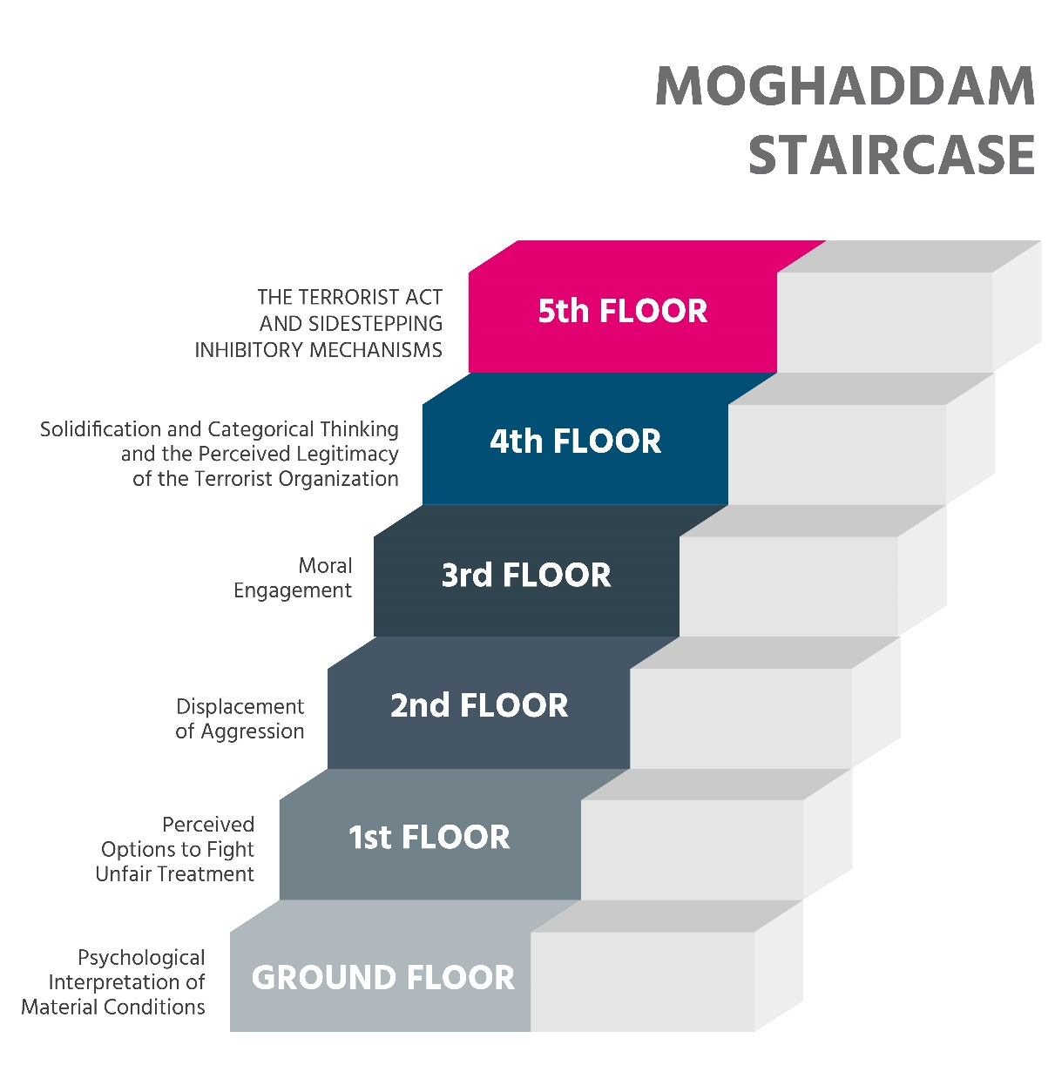
Phases of Radicalisation (1)
2
Source: Moghadam (2005)
Notes:
Instructions/text sheet 11
Radicalisation is generally seen as e non-linear and dynamic process. Some researches have tried to dissect this process into phases, or levels. Moghaddam has described the phases as a staircase, where a person would ascend onto different levels. Each level would need further beliefs which ultimately would make it easier to sidestep inhibitions to commit violence
Ground floor
The first floor is about your own interpretation of the status quo. And next about the present situation of the person himself and of society as a whole. That is actually what everybody does: it is normal behaviour but it can also form the basis for the transition to the second phase.
First step
The person has the feeling that he or the group to which he belongs is treated unfairly. At this point it is still possible to avert a further development towards radicalism. This can be done, for instance, by offering legitimate ways to tackle the experienced unfairness, like taking action or joining a political movement. If that doesn't happen and the person in question doesn’t see other possibilities? Then this reinforces the feeling of unfairness and the next step is quickly taken.
Second step
The person becomes aggressive. If he cannot reduce this aggression in a 'normal' way, he is more likely to show interest in radical solutions. If he then joins a radical group, he rises another step.
Third step
The person accepts and identifies with the beliefs of the radical group. The step to the next level becomes smaller.
Fourth step
The radical group and its morals are central in his life. He justifies terrorist actions.
Fifth step
On the fifth step he is prepared to commit terrorist acts. He avoids everything that can stop him from doing so.
The staircase model represents a kind of decision-making process. A Radicalisation process is the movement from one step to the next. On each "floor" there are doors that could be opened, or not. Whether someone stays on one floor or moves on to the next depends on whether the doors and rooms are experienced as opened or closed. As someone gets higher up the stairs, he sees fewer and fewer choices open. This may mean that the use of violence seems to be the only possible outcome in the end.

Slide 13
Phases of Radicalisation (2)
2
Sensitivity
Exploration
Membership
Action
Source: Feddes, Nickolson & Doosje (2015)
Notes:
Instructions/text sheet 12
This one is used by Feddes et al. (2015), who describes how a certain sensitivity could lead to exploration, which could lead to membership of certain extremist groups, which could lead to terrorist activities
Background information:
Somewhat similar is the model below (text to explain Feddes' model):
The literature often distinguishes four phases in the process of Radicalisation (Verhagen, Reitsma & Spee, 2010 and School & Safety, z.j.).
In a first phase it concerns a person or a group that is confronted with negative developments that can be a potential breeding ground for Radicalisation. Contextual or personal factors are therefore present which can be a risk factor for the development of radical thinking. Youth can be particularly vulnerable to enter this stage of sensitivity, because they are developing their identity, often quite uncertain, etc We will look more into that when describing causal factors.
In a second phase it concerns a person or group which is searching (for its own identity, for meaning, for a future perspective,...) and which is susceptible to radical ideas to a greater or lesser degree. If they do not find satisfying answers in mainstream society or with their parents, they might find them in radical groups and enter the next phase.
In a third phase it is about a person or a group which is touched by radical ideas, is already more or less radicalized and starts to spread these ideas itself.
In a fourth phase it is about a person or a group which further radicalizes and which is prepared to use undemocratic means and violence to achieve the presupposed ideals.
The problem with these models is that in reality people do not follow the different levels as distinguishable as on paper. So for a practitioner it will be very hard to tell if someone is on the first, or the second phase or floor. Still, it gives you an idea about the process

Slide 14
Possible signs of radicalisation
2
a change in behaviour
changing their circle of friends
isolating themselves from family and friends
talking as if from a scripted speech
unwillingness or inability to discuss their views
a sudden disrespectful attitude towards others
increased levels of anger
increased secretiveness, especially around internet use
accessing extremist material online
using extremist or hate terms to exclude others or incite violence
writing or creating artwork promoting violent extremist messages
Possible signs
Source: https://www.dcfp.org.uk/child-abuse/radicalisation-and-extremism/
Notes:
Instructions/text sheet 13
It can be hard to know when extreme views become something dangerous, and the signs of radicalisation aren’t always obvious.
There is no specific profile for a person likely to become involved in extremism or a single indicator of when a person might move to adopt violence in support of extremist ideas.
Clip (1.48 min) van Christianne Boudreau about signs her son displayed during radicalisation: https://www.youtube.com/watch?v=7Qm49T9C2sM (click on possible signs)
Radicalisation can be difficult to spot, but signs that could indicate a child is being radicalised include:
a change in behaviour
changing their circle of friends
isolating themselves from family and friends
talking as if from a scripted speech
unwillingness or inability to discuss their views
a sudden disrespectful attitude towards others
increased levels of anger
increased secretiveness, especially around internet use
accessing extremist material online
using extremist or hate terms to exclude others or incite violence
writing or creating artwork promoting violent extremist messages
Looking at these possible signs, what strikes you?
@Trainer: maybe some participants will recognise that a large number of these signals could also have other causes, like drug abuse, sexual abuse, other problems at home or signs of puberty
For more information: https://www.dcfp.org.uk/child-abuse/radicalisation-and-extremism/

Slide 15
Causal factors
2
Radicalisation
Political
Sociological
Psychological
Economic
Notes:
Instructions/text sheet 14
So far we have been looking at radicalisation from the outside, but what are the underlying causes? How come some people go to the next phase or next level? Unfortunately there is no unequivocal answer to that. There is no blueprint for radicalization. The causes can come from different angles and can be categorised in different ways. The first distinction can be: political, economical, sociological and psychological. Realise there is a complex interaction between these factors, which explains why every radicalised person has followed a unique pathway.
@Trainer
Background information:
RAN (https://ec.europa.eu/home-affairs/sites/homeaffairs/files/docs/pages/201612_radicalisation_research_gap_analysis_en.pdf): While a significant amount of research on violent radicalisation as well as measures to counter it already exists, an underlying lack of sufficient understanding concerning the way radicalisation works remains apparent. This is also due to the fact that different social science paradigms have been applied to this field. As a result, we have deterministic explanations, but also rational choice models, global explanations (i.e. models considering the micro-, the meso- and the macro-levels), social movement theories as well as attempts to reduce radicalisation to one underlying and overarching explanation (see for instance the quest for significance model or the ongoing debate between the role of ideological or social factors).
Vulnerable individuals
Whether a young person radicalizes also has to do with his individual characteristics and circumstances. Young people who are less firm and stable in life are susceptible to radical messages. One or more of the following difficulties can enlarge vulnerability to radicalisation:
psychosocial problems
behavioural problems
a slight intellectual disability
use of alcohol or drugs.
A youngster is extra vulnerable as he:
grows up in a broken or disrupted family
grows up without a father
was abused as a child.
Vulnerability, however, is not a condition for Radicalisation. Sieckelinck and De Winter (2015) have investigated in three countries what role the family plays in Radicalisation. They concluded that young people who radicalize often come from close, warm families. They are often intelligent, ambitious young people with a strong sense of justice.
Sieckelinck and De Winter (2015). Formers & families Transitional journeys in and out of extremisms in the United Kingdom, Denmark and The Netherlands. Den Haag: NCTV

Slide 16
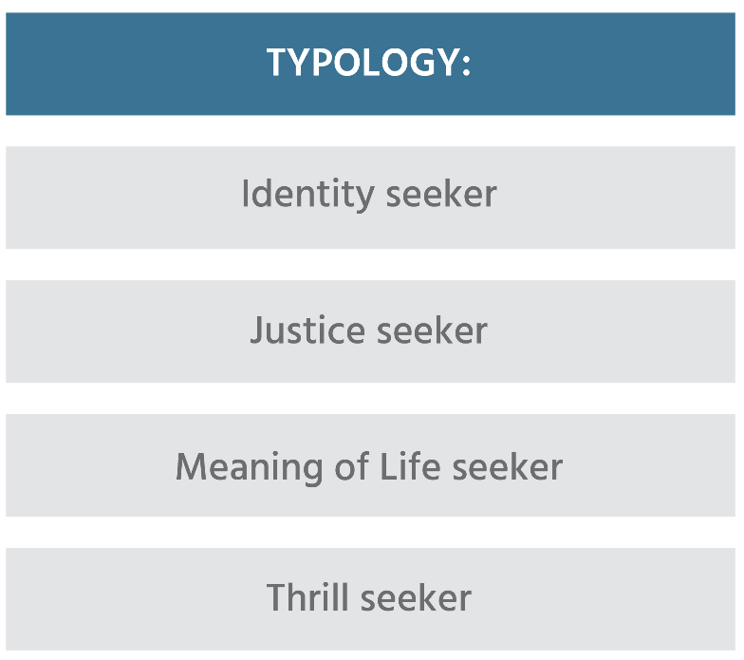
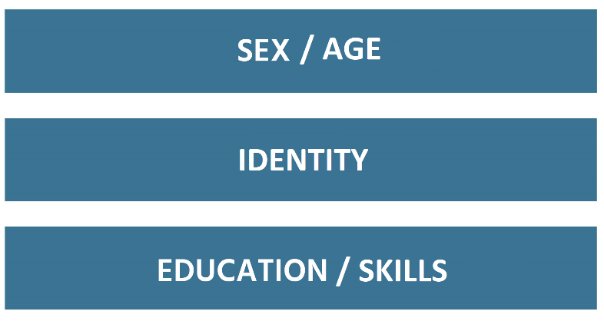
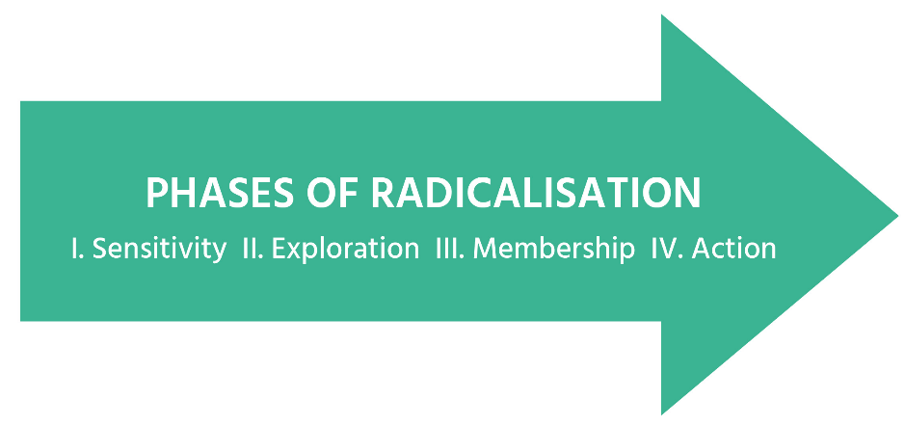
2
Personal experience with discrimination
Problems at home
Confrontation with death
Confrontation with propaganda
Part of radical group
Injustice against group
Calls to action
Government policy
War against group
Notes:
Instructions/text sheet 15
In this model you see the different components described in their interaction. (@trainer: Click to have the image appear in parts, parallel to the information described below))
There are triggers that influence and stimulate the radicalization process.
They act at different levels and can be sociological, psychological, political or economical
Triggers at the micro level (experiences at the individual level) include direct experiences of discrimination and collisions with authorities or detention, confrontation with death, problems at home (like divorce or fights with parents), loss of work or school.
At the meso level (the level of the group and other direct social connections), it involves e.g. meeting a radical person, noticing injustice against the group people identify with .
And on the macro-level (society, geopolitics) you can think of calls for action by ideological leaders, military attacks on one's own group and government policies aimed at one's own group.
The effect of these triggers can vary depending on the phase of radicalisation a person is in.
In addition, the effect can differ according to personal characteristics, such as what kind of person someone is; sex, age or education level and skills to deal with triggers.
The workshops in this project tie in with many of the mentioned factors and characteristics
Skills: are dealt with in the workshops critical thinking, anger management, e.g.
Identity: e.g. in the workshops narratives & identity and parenting
Personal experiences with discrimination: e.g. in the workshops conflict management and coaching
Problems at home: in the workshop coaching & parenting
Government policy: in the workshop proportionate state response
This is a rather complex picture, do you have any questions about it?
@Trainer, more background (to connect radicalisation to an increased vulnerability of youths)
Although there is not one path to radicalisation, researchers and practitioners recognise certain risk and protective factors for young people. Risk factors enhance the chance for radicalisation, but will definitely not predict that radicalisation necessarily occurs. Protective factors decrease the chance of radicalisation, but will unfortunately not always prevent a person form radicalising.
Adolescence itself is a risk factor, when young people are trying to find their place and meaning in a complex and often polarised world. This longing for connection can be fulfilled by an extremist group. Lack of skills to deal with specific experiences, e.g. anger as a result of perceived grievances. Life events, like a death in the family, or divorce can be a trigger. Also, mental health problems can sometimes add to the risk, as can the need for excitement.
This overview will be used repeatedly to keep participants aware of the link between the seven topics and radicalisation.

Slide 17
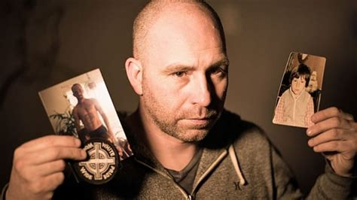
Push, Pull and Personal
2
Push
Pull
Personal
Photo by Duckrabbit
Notes:
Anther way to categorise causal factors is into
Push: The structural root causes of terrorism that drive people toward resorting to violence, e.g. state repression, relative deprivation, poverty, and injustice
Pull: The aspects that make extremist groups and lifestyles appealing to some people, and include, for example, ideology, group belonging, group mechanisms, and other incentives
Personal: More specifically individual characteristics that make certain individuals more vulnerable than their circumstantially comparable peers to radicalization. This includes for example psychological disorders, personality traits, and traumatic life experiences.
Click on the picture for an interview with a former radicalised person. Note the push, pull and personal factors
Source interview: https://www.youtube.com/watch?v=kHszRyuR2Ic

Slide 18
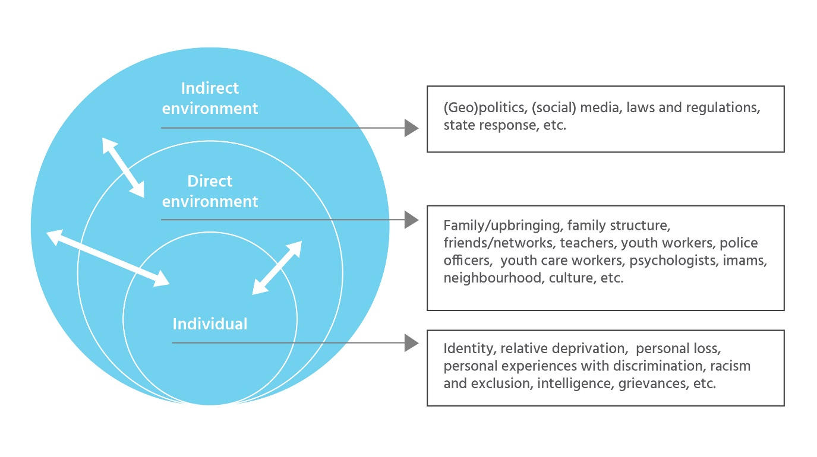
Levels of causal factors
2
Coaching and parenting
Critical thinking
Anger management
Narratives and identity
Simulation and discussion
Conflict management
Proportionate state response
skills
Notes:
Instructions/text sheet 17
Another way to order the possible causal factors is by dividing them into these three levels. Some factors can be attributed to the individual (like…), others to characteristics of the direct environment, that which is in direct contact with a young person (like …) and also more distant factors (like …)
Which one do you consider to be most important?
@trainer: it is never just one factor, but always a combination of factors which interact with each other
Where would you put the 7 topics that were chosen in this project?
As you can see, our intervention is focusing on strengthening the resilience of young people, by …
Extra sheet? -> A lack of protective factors, which allow vulnerabilities to combine with experiences and an ideological opening, sometimes resulting in radicalisation. In this project we are focussing on strengthening the protective factors and weakening vulnerabilities to create more resilience against experiences/radicalisation
@Trainer:
For more background information go to RAN (https://ec.europa.eu/home-affairs/sites/homeaffairs/files/docs/pages/201612_radicalisation_research_gap_analysis_en.pdf): While a significant amount of research on violent radicalisation as well as measures to counter it already exists, an underlying lack of sufficient understanding concerning the way radicalisation works remains apparent. This is also due to the fact that different social science paradigms have been applied to this field. As a result, we have deterministic explanations, but also rational choice models, global explanations (i.e. models considering the micro-, the meso- and the macro-levels), social movement theories as well as attempts to reduce radicalisation to one underlying and overarching explanation (see for instance the quest for significance model or the ongoing debate between the role of ideological or social factors). Whether deterministic or rational choice, complex or integrated, there is a general consensus among practitioners and academics alike that more research is needed to understand the causes, processes and mechanisms of radicalisation in order to be able to develop effective preventive and counter-measures. Research is also needed to understand the dynamics between radicalisation, violent extremism and terrorism. Namely, it is important to identify the kinds of radicalisation factors and processes which lead to violent extremism and terrorism, given that radicalisation is a broader and more complex phenomenon.
Measures aimed at combating and preventing radicalisation need to be more intimately connected to the insights we have on how radicalisation functions in the first place. For example, we know that discourse and narratives play a role in radicalisation. As participants in the WG session on counter-narratives in Vienna outlined, both practitioners and academics are, however, far from knowing precisely how these narratives are created and what their effect at the individual level is. Developing counter-narratives on the basis of such limited and general knowledge has of course little chance of success.
With respect to counternarratives, it is argued that there is relevant research on mind-sets and on ‘dos and don’ts’ in the field of communication studies; such research should also look into other areas of work such as drugs and crime and draw lessons from there. In the area of youth, families and communities, it is argued that there is a need to enlarge the conceptual and theoretical focus of research on radicalisation by a) not considering radicalisation as exceptional, but as entailing mechanisms which occur in other phenomena, too – such as joining a group or wanting to be cool; b) using existing research in the areas of crime and family dynamics and roles.

Slide 19
Coaching and parenting
3
A good mentor?
A good parent?
Notes:
Instructions/text sheet 18
Now that we have a general idea about the range of factors that can contribute to radicalisation we focus on counteracting them. The first topic to do so deals with the way parents and first line practitioners interact with their children and pupils in their capacity as potential figures of authority and influence.
@Trainer
The trainer asks participants to answer the following questions by writing no more than three lines on a sheet of paper. (depending on the audience you can choose one or two questions that fit the audience)
“How can you describe a good coach/mentor?”
“How can you describe a good parent?”
@Trainer:
This is part of an icebreaker in the workshop Coaching and parenting
The objective is for people to get a clear picture of what good parenting/mentoring/coaching is (to them)
Since many terms exist and are used alternately, (eg coaching, parenting, mentoring, teaching, counselling, consulting) a general idea of what we mean by parenting, mentoring/coaching is helpful. It is not a problem if participants together create a definition which differs from the descriptions below, just make sure it has elements of support during personal development and long term relationship.
From D3.2.1
Coaching: the concept started from being understood as an advice-giving process and developed through time to come under the influence of a range of therapeutic or personal-development approach, which tends to go deeper and is more prolonged, rather than the goal-oriented approach, which aims for immediate results (Stober & Grant, 2006). On the other hand, life coaching has been defined as a professional partnership between a coach and an individual focused on the discovery of one’s life direction, and is based on a holistic and action based approach that promotes the process of understanding overall life purpose (Gilmore, et al., 2012, p. 1).
Mentoring: traditionally, mentoring has been defined as a relationship between an older, more experienced mentor and a younger, less experienced protégé for the purpose of helping and developing the protégé’s career (Kram, 1985) (Levinson, Darrow, Klein, Levinson, & McKee, 1978).
Parenting or parental style: the way in which children, in general, perceive the sum of parental behaviours and practices used by their parents during lifetime in order to shape their developmental process (Baumrind, 1991). It consists of two main dimensions, as follows (Stavrinides & Nikiforou, 2013, p. 60):
demandingness – which describes the expectations of parents with regards to the behaviour and socialization of their children;
responsiveness – which refers to the parent’s general tendency to provide their children with warmth, positive attitudes and support.

Slide 20
Coaching and parenting
3
Cognitive changes
Psychological changes
Emotional changes
Social changes
Biological changes
Notes:
Instructions/text sheet 19
Child development starts at birth and ends with adolescence. During that time biological, social, emotional, cognitive and psychological changes take place. In each phase a child has a central challenge to overcome. Teenagers and adolescents are on a road from childhood to maturity. Forming their identity along the way.
Background information from D3.1.1
Adolescence is the most challenging life stage for both teenagers and parents, due to the fact that is considered to be a transition phase between childhood and adulthood. During their adolescence, teens experience many changes, from biological, to social, emotional, psychological and cognitive, developing their own identity and struggling to find their place within the society. Given the fact that adolescence is the period when teens begin to argue with their parents when they have different opinions and search to distance themselves from their parents and join different peer groups, the present deliverable aims to identify proper manners and efficient strategies to approach the relationships children-parents, in order to avoid adolescents becoming victims of polarization and radicalization, pushed by tense interactions with their parents. The rationale for using coaching and parenting exercises is motivated by the need to permanently adapt the parenting style to the needs and expectations of teens, who are in continuous changes generated by all societal developments (e. g. access to information, too much information, fake news etc.). Moreover, teaching and parenting strategies allow parents to better understand their children’s behaviour, decisions and reactions, enabling them to prevent their teens from becoming an active part of the radicalization/polarization process, as a consequence of different social problems unidentified or treated in the wrong manner.

Slide 21
Coaching and parenting
3
Triggers for
Radicalisation
search for identity
personal fulfilment
lack of self-esteem
individual frustration and insult
Notes:
Instructions/text sheet 20
The way adolescents are guided during this socialisation may assist youths into growing into balanced and mature young adults. It could also be that during this journey to adulthood triggers for radicalisation may develop. The questions that people ask themselves during this period are:
Who am I? Where do I belong to?
What is my role on this earth?
How can I contribute?
Am I good enough?
How do others see me?
How can I cope with adversity?
@Trainer – This should explain the reason why coaching and parenting are considered important in preventing radicalisation. Background information (from D3.2.1):
Radicalisation processes are often triggered by a ‘search for identity contributing to a sense of belonging, worth and purpose’ (Dalgaard-Nielsen, 2008b), personal fulfilment (Silverman, 2017), lack of self-esteem (Borum, 2017; Chassman, 2016; Christmann, 2012; Dawson, 2017; Lindekilde, 2016; Senzai, 2015), individual frustration and insult (Beutler, 2007).
Coaching and parenting techniques - understand, learn how to use, integrate into everyday professional interaction with individuals vulnerable to radicalisation and violence those strategies and techniques that can empower mentors, coachers, parents, tutors and other figures of authority in the life of adolescents effectively develop efficient strategies and methods to approach the relationship mentor-mentee, coach-student, child-parent etc. , in order to determine adolescents avoid becoming a victim of polarization and radicalization.

Slide 22
Coaching and Parenting
3
Skills youth
Managing emotions
Goals parents/coaches
Facilitating positive identity formation
Positive reinforcement
Personal growth
”The way we treat our children directly impacts what they believe about themselves.”
Ariadne Brill
Develop empathy
Develop team skills
Stop stereotyping
Notes:
Instructions/text sheet 21
The main goals parents and coaches have in this stage of development are to make positive identity formation possible, offering positive reinforcement and stimulating personal growth.
The main skills teenagers must address during their emotional and behavioural development process, in which parents and mentors/coachers play in important part, are as follows: Recognizing and managing emotions, Developing empathy, Developing teamwork skills and to Recognize, avoid and stop stereotyping and discriminating people
Coaching and parenting might offer the right tools to consolidate resilience and positive identity formation.
Counselling and family pedagogy are two psychoeducational models of intervention relatively new, which aim to provide, both to the wards and to parents, understanding and the right psychological and emotional tools to support themselves/their children by providing them with the ability to manage emotions, appreciate differentiation, work with positive reinforcement, manage stress situations, include social support,
@Trainer – background
Coaching and parenting techniques are two essential instruments that play an important role in the development process of adolescents’ identity formation and behavioural reinforcement. Using coaching and parenting in addressing personal growth and children development is not a form of psychotherapy. It is however a form of psychoeducational intervention, in which the role-model, mentor, coacher, or parent becomes skilled in facilitating identity differentiation, positive reinforcement and personal growth in the mentee, student, child. This form of intervention creates premises for improving relational frameworks and generating positive behavioural change, while offering a safe space to exercise skills and techniques.
The main skills teenagers must address during their emotional and behavioural development process, in which parents and mentors/coachers play in important part, are as follows (D3.2.1):
Recognizing and managing emotions - in order to be able to manage any difficult situation that may appear, teens need to first develop their ability to identify the source of their feelings, to be able to label properly the problem. When feelings are not labelled in a proper manner, they might become a source of violence or bad behaviour, adolescents seeking to manage their emotions in unconstructive ways, because they do not know the source (Goleman, 1994);
Developing empathy – after learning how to correctly label their feelings, teens need to develop their ability to understand the emotions of those around them, and most important, they need to learn to take those feelings into account when communicating/interacting. Therefore, empathy can be taught in different ways, from helping adolescents to empathize with different cultural and religious groups (avoid discriminating attitudes), to understating what are the consequences of prejudice and assumptions (Aronson, 2000);
Developing teamwork skills – in nowadays society, the ability to cooperate and work together with others in order to achieve a common or personal goal is the key to survival – even a video game requires having to cooperate with other players in order to reach next level. In the same manner, in real life, working together with others plays an important role not only in establishing interactions and connections, but also in working for a common good (Santrock, 2001);
Recognize, avoid and stop stereotyping and discriminating people - after learning how to control and express their feelings towards themselves and towards others, teens need to develop their understanding of what is a stereotype and how can it affect the relationship with their peers. Moreover, adolescence is the most challenging life stage in terms of stereotypes impact on young people (e.g. gender stereotypes, sexual bullying etc.).
How can parents and practitioners help youths to develop these skills?

Slide 23
Workshop on coaching and parenting
3
Who
First line practitioners
What
Concept of radicalisation
Exercises and simulations
How
Knowledge
Practice skills
Parents
Result
Recognising signs
Parenting / coaching skills
Notes:
Instructions/text sheet 22
How can parents and practitioners help youths to develop these skills? The workshop that is offered in this project is meant to support them in doing so.
It is meant for figures of authority, like mentors, coaches, parents, tutors etc.
For more detailed information I recommend the Manual for trainers of the Workshop Coaching and Parenting (show the site where it can be found)
The exercises are spit in two kinds. One group is focussing on your role as parent and coach. The second group offers exercises you can do with your child or coachee.
We will now look at an example of possible exercises from the workshop

Slide 24
Coaching and parenting: Exercise
3
Present your role model
Most influential person
3 other characteristics of your role model
Describe why
How your role model can help counter these drawbacks
3 major drawbacks for youths today
Notes:
Instructions/text sheet 23
This is an example of one of the exercises in the workshop Coaching and Parenting. Please take a paper and pen (or tablet/smartphone/laptop). My suggestion is to first experience how the exercise goes and then discuss the objectives
@Trainer
This exercise takes about 1 hour
Step 1: The trainer will ask each participant to think about a person that influenced them most in a positive way and write down the main features of that model, as well as their motivation to consider that person the most influential one in their lives.
Step 2: Participants will be asked to think about three major drawbacks to the personal development of young people today and list them.
Step 3: Participants will be asked to think about and describe the way in which their model figure can help them minimize the effects of the drawbacks.
Step 4: Participants will be asked to think about and note down another 3 characteristics they consider a role model should possess (other than the ones already identified in connection with the person described).
Note: for those participants who do not know how to write, the moderator will create a small working group to discuss the above-mentioned points.
Step 5: The trainer will invite each participant to present their role model in front of the group, and to tell how this can help in working with youths, engaging all the participant to comment and discuss.

Slide 25
Coaching and parenting: Exercise
3
Build your own role model
objective
instructions
target audience
duration
Notes:
Instructions/text sheet 24
The exercise is named Build your own role model
Ask participants: What do you think about the idea behind this exercise?
The objective is to let parents and coaches think about the positive influences they have experienced in their lives and translate that to being a positive role model for their children / pupils
Each workshop comes with a manual that describes the objective, target audience and timing of each exercise. Also instructions are given about the execution and materials needed for the exercise.
Objective
In the process of personal development experienced during adolescence, young people tend to copy in actions and behaviour the person they most appreciate (a parent, family relative, older friend, superhero, movie star etc.). These exercises will help participants build their own role model starting from the person they consider most influential in their lives and translate that to being a positive role model themselves
Target audience
Puberty/teenage and parents

Slide 26
Critical thinking
4
Critical thinking
Deliberately analysing information
based on facts
to make better judgment and decisions
Apply to polarising messages like:
Binary, us-them, black and white propaganda
Fake news
Biased reporting
Notes:
Instructions/text sheet 25
The next topic is critical thinking. Lack of it is considered to be a risk factor for radicalisation.
Ask participants for their first thoughts on the concept of critical thinking. What is it to them?
Click on cartoon (source LIBRe): https://www.youtube.com/watch?v=-eEBuqwY-nE
@trainer, background
The most fundamental definition of thinking is very simple and intuitive: all humans think. But critical thinking begins when we start thinking about our thinking with a view toward improving it (Paul & Elder, Critical Thinking. Tools for Taking Charge of Your Professional and Personal Life, 2014, p. 6).
Critical thinking can be seen as having two components: (1) a set of information and belief generating and processing skills, and (2) the habit, based on intellectual commitment, of using those skills to guide behaviour. It is thus to be contrasted with: (1) the mere acquisition and retention of information alone, because it involves a particular way in which information is sought and treated; (2) the mere possession of a set of skills, because it involves the continual use of them; and (3) the mere use of those skills (“as an exercise”) without acceptance of their results.
Ask participants: In what way is critical thinking significant in the process of radicalisation? Discuss in twos
Then click for second text block
@trainer, background
By being taught how to think critically, we learn how to pursue “truth” over our own biases, persist through challenges, assess our own thinking fairly, and abandon mistaken reasoning for new and more valid ways of thinking.
Why is critical thinking important when addressing societal polarization caused by the adoption and spread of extremist ideologies? Because it empowers young people to think independently, to make sense of the world based on personal experience and observation, and to make critical well-informed decisions in the same way. As such, they gain confidence and the ability to learn from mistakes as they build successful and productive lives.
Thinking or reasoning involves objectively connecting present beliefs with evidence in order to believe something else. By comparison, critical thinking is a deliberate meta-cognitive (thinking about thinking) and cognitive (thinking) act whereby a person reflects on the quality of the reasoning process simultaneously while reasoning to a conclusion. The thinker has two equally important goals: coming to a solution and improving the way she or he reasons (Moore, 2007, p. 2).
Why is critical thinking so important? From https://www.radicalrightanalysis.com/2018/07/26/uk-prevent-building-resilience-to-radicalisation-through-critical-thinki/
1 - because extremists thrive on propagating a binary, black and white view of the world, encouraging a “them against us” mentality. Most of the high-risk Prevent referrals I have dealt with were attracted by the certainty of clear extremist narratives that left no room for nuance or doubt. From the 15 year old white supremacist who believed that Muslims wanted to kill westerners and that a race war was on the horizon, to the young convert to Islam who believed that Muslims were not welcome in the UK and so the only place he could freely practice his faith was in the so-called caliphate of the Islamic State.
2 - our social media platforms are awash with so-called ‘fake news’ and propaganda and if children are to be well informed and safe it is important to question the source of nearly everything they see online. From seemingly innocuous rumours about celebrities to malevolent attempts by extremist groups to spread fear or recruit vulnerable people, careful consideration is required to avoid falling prey to emotional manipulation. The pull factor of ideologies and manipulative or false information
3 - Added to this is the damage to integration and community cohesion that can result from a lack of critical thinking in reporting, even within the mainstream media. Consider the language used when national newspapers cover terrorist attacks. How quickly are Muslim offenders labelled terrorists and their crimes linked to faith by some outlets? Meanwhile, a more nuanced view is sometimes taken when attackers are non-Muslim.

Slide 27
Workshop on critical thinking
4
Who
First line practitioners
What
Concept of radicalisation
Exercises and simulations
How
Knowledge
Practice skills
Result
Recognising signs
Critical thinking skills
Notes:
Instructions/text sheet 26
How can practitioners help youths to develop critical thinking skills? The workshop that is offered in this project is meant to support them in doing so.
It is meant for first line practitioners like teachers, social workers, police officers, mentors, psychologists etc.
‘The Critical Thinking Lab’ provides a framework, scenario, and detailed set of exercises and simulations to assist first line practitioners learn how to encourage the developing of critical thinking skills for children and youth. The aim is to subsequently equip children and youth with the capacity for self-guided, self-disciplined thinking, empowering them to think independently, to make sense of the world based on personal experience and observation, and to make critical well-informed decisions in the same way.
With this knowledge and skills participants will learn how to:
Recognise the signs of radicalisation
Recognise the signs of simplistic and simplifying thinking in themselves and others
Identify the psychological fundamentals of thinking, how it affects the attitudes and behaviours of the individual, how it can be enhanced towards self-directed, self-disciplined, self-monitored, and self-corrective thinking expressions
Understand how they can offer support in the short term and advice to troubled individuals on the psychological support they might need in the long run
Develop social responsibility and social skills to address individuals with stereotyped thinking
Reflect on how strategies and tactics used in addressing biased thinking can be integrated and adapted to their professional routine
For more detailed information I recommend the Manual for trainers of the Workshop Critical Thinking (show the site where it can be found)
We will now take an example of possible exercises from the workshop

Slide 28
Critical thinking: Exercise 1
4
Report conclusions to greater group
Form groups of 6-8
1st person unfolds the paper and reads aloud
1st person writes one sentence on ‘hate’
Write sentence, fold and pass to the next person
Fold the paper and pass to 2nd person
Notes:
Instructions/text sheet 27
This is an example of one of the exercises in the workshop Critical thinking. Handout a piece of paper (per group). My suggestion is to first experience how the exercise goes and then discuss the objectives
@Trainer
When the TTT is executed on line, this exercise needs adjustment: ask everybody to write one sentence on ‘hate’ on a piece of paper. At your signal ask all participants to copy that sentence on the digital whiteboard (or similar central boards). Ask participants to reflect on what they see
This exercise takes about 20-30 minutes. You can swap the topic to your liking (hate/ government/ discrimination/ refugees/ corona/ …)
After writing:
The goal is for participants to understand how each participant adds his/her own vision on the topic and how their perspectives vary.
Additionally, they learn to apply their knowledge and logic to explaining themselves as clearly as possible.
At the end, the trainer collects the writings and present to the group the definitions, explaining the importance of having different perspectives when addressing a problem.
Step 1: form groups of 6-8 participants. One piece of paper per group
Step 2: ask the first participant from each group to write one sentence describing on a piece of paper what hate is to him or her.
Step 3: the participant folds the paper down to cover the sentence received. Now only their sentence is visible and no other, so each time they pass students can see one sentence. The first participant then passes the paper to the second one who adds her/his sentence that illustrates the understanding of the topic also in a single sentence.
Step 4: repeat folding and passing until every person in the group has written down a sentence
Step 5: 1st person unfolds the paper and reads all definitions aloud. Discuss what strikes you
Step 6: report group conclusion to the central group
@trainer
At the end explain the importance of having different perspectives when addressing a problem.
Ask how this can help in working with youths, engaging all the participant to comment and discuss.
It is important to note that analysing a problem from different perspectives is helpful in finding the best way to solve it and reducing uncertainty.
Also, by acknowledging the fact that humans have different perspectives, the trainer reinforce the notion of tolerance and acceptance of diversity.

Slide 29
Critical thinking: Exercise 1
4
Try one sentence
objective
instructions
target audience
duration
Notes:
Instructions/text sheet 28
This exercise is named Try one sentence
Ask participants: What do you think about the idea behind this exercise?
The objective is to understand the impact of different perspectives on the same topic
Background trainer:
Objective
“One of the many ways in which our mind attempts to make life easier is to solve the first impression of the problem that it encounters. Like our first impressions of people, our initial perspective on problems and situations are apt to be narrow and superficial. We see no more than we’ve been conditioned to see — and stereotyped notions block clear vision and crowd out imagination. This happens without any alarms sounding, so we never realize it is occurring”. This exercise shows that many perspectives of the same topic exist

Slide 30
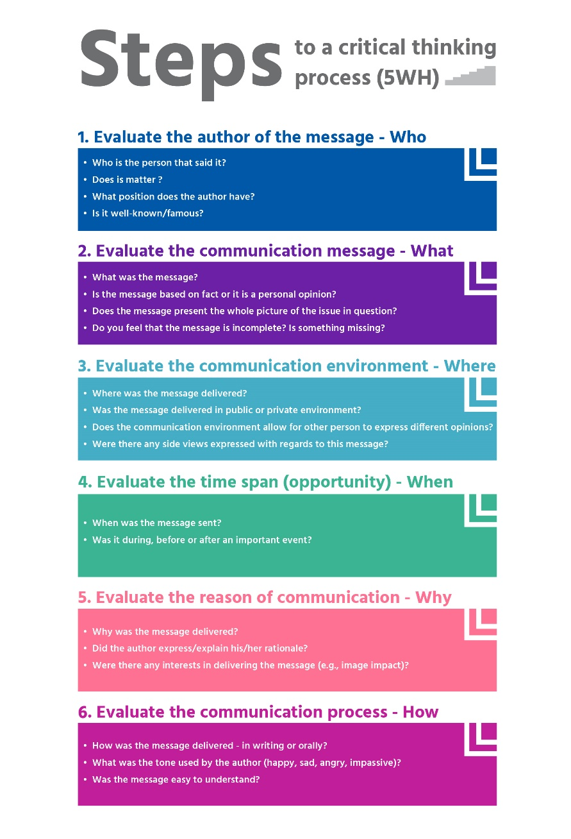
Critical thinking: Exercise 2
4
Make pairs
Choose article
Answer the 6 questions
Trustworthy?
Notes:
Instructions/text sheet 29
This is another example of an exercise from in the workshop Critical thinking. Please take your laptop (or tablet/smartphone). My suggestion is to first experience how the exercise goes and then discuss the objectives
@Trainer
The picture on the right of this slide may be hard to read. Face-to-face a handout could be a solution.
This exercise takes about 45 minutes
Step 1: The trainer divides the group in pairs. [on-line break-out sessions can be organised with certain platforms]
Step 2: Then ask them to choose an article related to a recent event or development in your local language (e.g. immigration, global warming or development of technology like internet of things, artificial intelligence) and present it to the audience. (Or choose to provide articles)
Step 3: the trainer asks each team to provide answers to all 6 questions in the order presented in the infographic below. Distribute handouts
Step 4: In the end, the trainer asks each group to decide if the article can be trustworthy or not, based on the answers provided to the guiding questions, stressing the importance of questions for the critical thinking process.

Slide 31
Critical thinking: Exercise 2
4
The 6 questions
objective
instructions
target audience
duration
Notes:
Instructions/text sheet 30
This exercise is named The six questions
Ask participants: What do you think about the idea behind this exercise?
The objective is to understand the role of questions for critical thinking
Each workshop comes with a manual that describes the objective, target audience and timing of each exercise. Also instructions are given about the execution and materials needed for the exercise.
The six questions
Objective
Understanding the role of questions for critical thinking

Slide 32
Feedback
5
Exercises
What strikes you?
A good mentor/parent?
Build your own role model
Try one sentence
The 6 questions
FEED
FEED
BACK
Notes:
Instructions/text sheet 31
In this first session of the TTT, we addressed the concept of radicalisation, its manifestations and possible causes. We then introduced the first two workshops of project ARMOUR, on Coaching & Parenting and on Critical Thinking.
Distribute [or if online: email] T2 survey day 1.
Explain that participants can use the number of the exercise as shown on the ppt slide to add comments on a specific exercise
Did they help you get to grips with the concepts?
Are they useful for use with young people.
Which ones can you use in your work (or private)?
Next time we will look at anger and narratives as contributing factors in radicalisation

Slide 33
А question for the next time
6
What do you need most in your job context to contribute to the prevention of radicalisation?
Notes:
Instructions/text sheet 32
For the next day I would like you to think about what you need in your job context

Slide 34
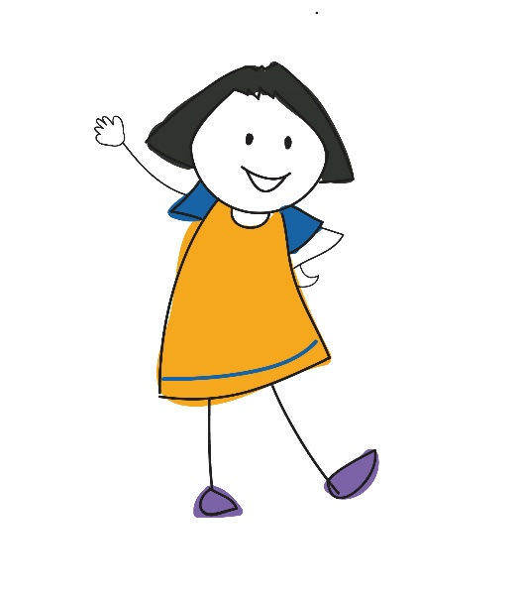
Conclusion
6
What was most interesting to you today?
What was most interesting to you today?
Notes:
Instructions/text sheet 33
@Trainer: Make a round and collect highlights
The rationale behind this is to end with a positive and to reinforce these particular topics

Slide 35
Thank you!

