Slide 1
Train the Trainer
Session 2: Preventing Youth Radicalisation
Notes:
Instructions / suggested text sheet 0
Welcome back (check if attendance list is signed by all participants)
@Trainer (see manual for further instructions)
Needed
Attendance list
Laptop/PC and beamer
Pens and paper for participants
Flip over
markers, cards, puzzle, white paper sheets, scissors, *smartphones to access Pauliseverywhere.
internet access,
Handouts exercises ( )
Surveys
Suggested planning day 2 (depending on your choice of exercises)
Walk-in, coffee, tea 15 min
Introduction 45 min
Explanation radicalisation 45 min (depending on initial knowledge, this can be extended or shortened)
Break 15 min
Relation between Anger and radicalisation 45 min
Exercise(s) Anger management 60 min
Lunch 60 min (take time for exchange of experiences and building network if possible)
Relation narratives 30 min
Exercise(s) Narratives 45 min
Break 15 min
Exercise(s) Narratives 30 min
Feedback and conclusion 15 min
Usually things take more time because of questions and interaction so take about 7 hours. Depending on the number of participants, their level of knowledge at the start and the amount of discussion, the amount and choice of exercises, the estimated time of the first session can vary.
One could start at 09.00 AM and plan to end at 16.30 PM.

Slide 2
Recap of Day 1
7 workshops
Individual capacity building
Coaching and parenting
Critical thinking
Community capacity building
State response
Anger management
Narratives and identity
Debating and simulation
Conflict management
Proportionate state response
Introduction
Radicalisation
Coaching and parenting
Exercises
Critical thinking
Exercises
Feedback
1. A good mentor/parent?
2. Build your own role model
Understanding radicalization in general
Relation between radicalisation and specific topic
Clarification specific topic
Exercises
“a phased and complex process in which an individual or a group embraces a radical ideology or belief that accepts, uses or condones violence [ ] to reach a specific political or ideological purpose.”
1. Try one sentence
2. The 6 questions
Notes:
Instructions / suggested text sheet 1
@Trainer
Start with a rehearsal of last time. Take some time because it stimulates memory and activates the participants, and it lays a better foundation for day 2.
You can show the selected pictures to jog their memory, but better to just let them tell you the content
(NB this sheet looks a bit chaotic, but if you ‘play’ it, it will be clear)
What did we do last time? What do you remember?
Introduction
– 7 workshops (coaching and parenting, critical thinking, anger management, narratives, conflict handling, simulation and discussion, state response)
– set up workshops (radicalisation in general, the relationship between radicalisation and the workshop’s topic, insight into the specific topic, exercises)
Radicalisation
– definition
– trigger model
– different ideologies: religiously centered, or extreme-right, extreme left or single issue, like animal activism and extremism
– possible signs
Coaching and Parenting
Child development starts at birth and ends with adolescence. During that time biological, social, emotional, cognitive and psychological changes take place. In each phase a child has a central challenge to overcome. Teenagers and adolescents are on a road from childhood to maturity. Forming their identity along the way.
Explanation on the way coaching and parenting can either increase of decrease the chances of radicalisation
Exercises:
What makes a good mentor/parent?
Build your own role model
Critical thinking
Explanation on how easily people will fall prey to propaganda and lies if they do not think critically
What is critical thinking?
Exercises: experiencing one or more of the exercises to improve critical thinking
Try one sentence
The 6 questions
Feedback – Very important, to improve the effectiveness of the training
I also asked if you would think about things you need in your job context regarding radicalisation.

Slide 3
Question
What do you need most in your job context to contribute to the prevention of radicalisation?
Notes:
Instructions / suggested text sheet 2
At the end of the first day, I asked you to think about what you need most in your job context.
@Trainer
Collect answers (and check if they will be dealt with in the course)

Slide 4
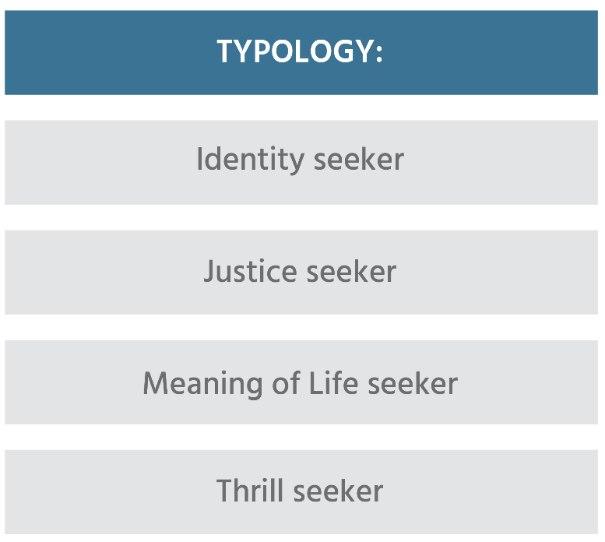
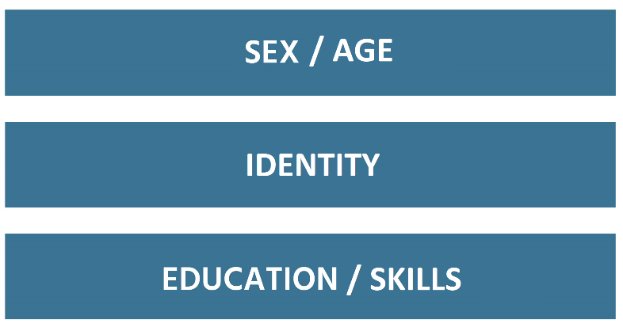
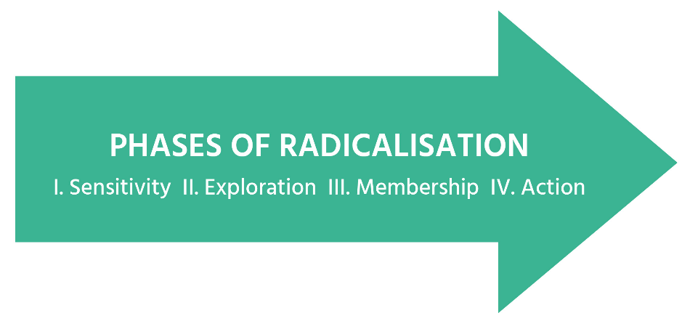
Personal experience with discrimination
Problems at home
Confrontation w. death
Confrontation with propaganda
Part of radical group
Injustice against group
Calls to action
Government policy
War against group
Notes:
Instructions / suggested text sheet 3
We ended our exploration of radicalisation with the trigger factor model which described several components and their interaction.
And saw how the workshops in this project tie in with many of the mentioned factors and characteristics
Skills: e.g. critical thinking, anger management, debating
Identity: e.g. narratives and parenting
Personal experiences with discrimination: e.g. conflict management and coaching (so teachers know how to respond)
Problems at home: parenting
Government policy: proportionate state response
Today we will continue with three other contributing factors of radicalisation: anger, narratives and discussion skills.

Slide 5
Today’s programme
Recap of Day 1
Anger management
Exercises
Narratives and identity
Exercises
Debate and simulation
Exercises
Feedback and conclusion
Notes:
Instructions / suggested text sheet 4
Anger – what is it, how can it fuel radicalisation and how to control it
Exercises– experimenting with exercises to help youth to manage their anger
Narratives– explanation on the way narratives and identity forming can either increase the chances of radicalisation
Exercises– experiencing one or more of the exercises to use narratives in a more positive way
Debate and simulation
Exercises
Feedback – your feedback on the exercises of the second day

Slide 6
Anger: Exercise
What struck you?
How do I know I am angry?
Discuss in twos
What events/people/ places/things make me angry?
How does my angry reaction affect others?
How do I react when I'm angry?
Notes:
Instructions / suggested text sheet 5
We will start with an example of one of the exercises in the workshop Anger Management. Please take a paper and pen (or tablet/smartphone/laptop).
#1 Brainstorming – free associations Icebreaker 1 (15-20 min)
@Trainer
This exercise is one of the icebreakers in the workshop on Anger Management. It takes about 15-20 minutes
Step 1-4: Trainer asks participants to answer the following questions (one by one) by writing no more than three words per question on a sheet of paper. (4 min)
Step 5: each participant chooses a partner and shares answers with him/her. (4 min)
Step 6: a 2 minutes roundup discussion is used by the trainer to collect possible answers on a flipchart. Hopefully, the observations of the participants point to the objective of this exercises: to become aware of one’s personal way of experiencing and dealing with anger, and to be able to recognise it. People become aware that anger is something we are all familiar with.
Trainer closes the ice breaker by pointing at the most common answers and telling that we will come back to the concept of anger later on.

Slide 7
Anger
‘Try to understand why they are angry and try to challenge this anger.’
Source: terratoolkit.eu
Notes:
Instructions / suggested text sheet 6
https://vimeo.com/113623893
@Trainer
Clip to illustrate the connection between anger and radicalisation (show 9.46-12.42 min)

Slide 8
Anger
Insecurity
Experienced injustice
Anger
Radicalisation
Insufficient self correction of impulses
Source: Van den Bos (2019)
Notes:
Instructions / suggested text sheet 7
One of the causal factors that has been scrutinised by researchers is experienced injustice, like unfair treatment, relative deprivation, immorality etc.
This can become a push factor to radicalisation, especially when people feel insecure, or are not able to control certain emotions.
P19 Kees van den Bos (2019)
The anger pushes them away from mainstream society, because it causes a negative association.

Slide 9
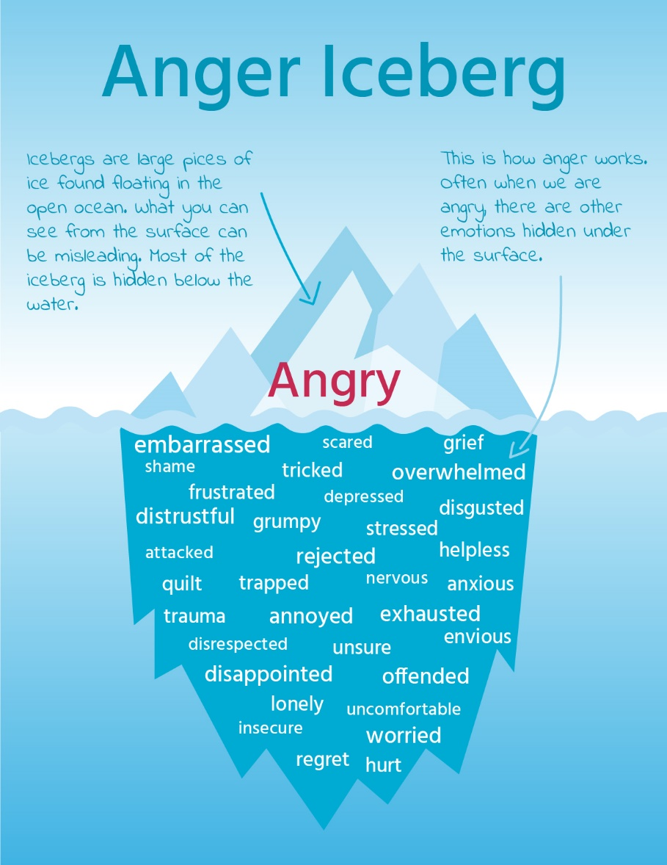
Anger
Primary and secondary emotion
Based on: https://www.gottman.com/blog/the-anger-iceberg/
Notes:
Instructions / suggested text sheet 8
When people are angry it is often not the only emotion in play.
Pg 13 of D3.2 Anger as second-hand emotion
Anger can be a fundamental and primary emotion, but is also often called a secondary emotion because we tend to resort to anger in order to protect ourselves from or cover up other vulnerable feelings. A primary feeling is what is felt immediately before we feel anger. We almost always feel something else first before we get angry. We might first feel afraid, attacked, offended, disrespected, forced, trapped, or pressured. If any of these feelings are intense enough, we think of the emotion as anger.
As the drawing illustrates, anger is like an iceberg in that only some of the emotions are visible. The other emotions exist "below the water line" where they are not immediately obvious to outside observers. (http://creducation.net/resources/anger_management/anger__a_secondary_emotion.html)
Why do you think this could be relevant in this context?

Slide 10
Anger
Natural and automatic response
Fundamental yet often secondary emotion
Push factor
Managing it is a skill
Direct vs chronical
Notes:
Instructions / suggested text sheet 9
Some characteristics of anger
It is considered a natural and mostly automatic response to adverse acts
Anger is a fundamental emotion. And it often takes the place of an underlying emotion. Some people feel it is a ‘bad’ or negative emotion, others say it only becomes a problem when someone is holding on to anger and it becomes chronical.
As explained before, anger is a push factor towards radicalisation
together with a sense of identity /‘quest for significance’, individual frustration and insult, cognitive-social factors like risk taking and reduced social contact, personal victimization, displacement of aggression
Learning to manage anger properly is a skill, it does not come by instinct. It is related to how we place a threshold to a complex interplay with other emotions.
People who are incapable of getting angry are also incapable of standing up for themselves. It is important then that people learn how to express anger appropriately.
People need to learn healthy and socially respectful ways to express angry feelings, and to not to let anger get out of control to the point where it negatively affects relationships, employability and health.
It is more satisfying to feel angry than to acknowledge the painful feelings associated with vulnerability.

Slide 11
Workshop on anger management
Who
First line practitioners
What
Framework radicalisation
Exercises and simulations
How
Knowledge
Practice skills
Result
Recognising signs
Anger management skills
Notes:
Instructions / suggested text sheet 10
How can first line practitioners help youths to develop anger management skills? The workshop that is offered in this project is meant to support them in doing so.
‘The Anger Management Lab’ looks into how to better teach anger management as a form of psychoeducational intervention. It comprises a series of exercises that, if used in convergence, can help first line professionals working with young people vulnerable to radicalisation use anger management strategies and techniques to help divert them from violent an destructive behaviour. The techniques described have been inspired by the work of coachers and therapists in teaching and promoting anger management.
The underlying idea is that by helping them to dissipate or control their anger will assist in preventing them from radicalization/polarization.
For more detailed information I recommend the Manual for trainers of the Workshop Anger Management (show the site where it can be found? Or give a printed version as a gift? Put is on the usb-pen)
We will now take an example of possible exercises from the workshop

Slide 12
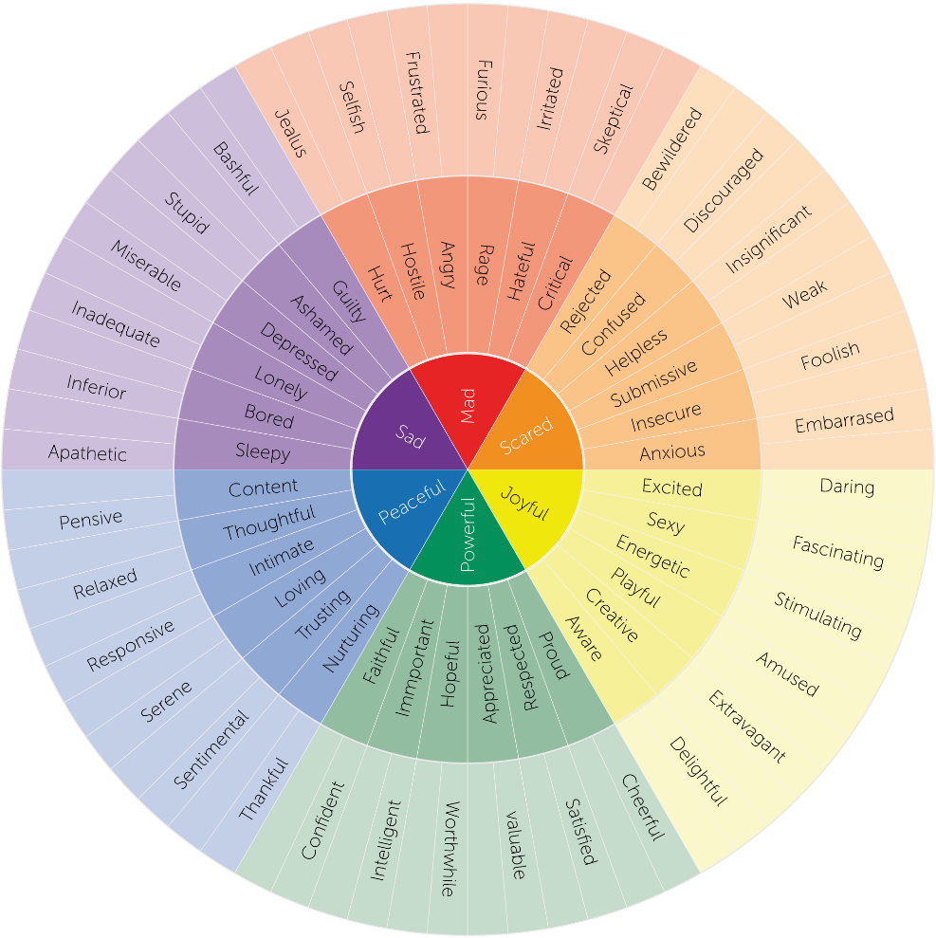
Anger management: Exercise 1
Wheel of emotions
(Robert Plutchik, 1980)
Hints:
Choose an emotion from the wheel
Express it non-verbally so others can recognise it
Notes:
Instructions / suggested text sheet 11
This is an example of one of the exercises in the workshop Anger Management. Multiple options are available and most are easy to replicate with youths. My suggestion is to first experience how the exercise goes and then discuss the objectives
@Trainer: Takes 20-30 min (depending on amount of participants)
Hand out the wheel on paper.
This option asks every participant (who wishes to join) to choose an emotion and express it in front of the group. Others have to guess which emotion is expressed.
Note: some people find this hard, create a safe environment and try to encourage them, but also allow people to opt out
Note: for age groups younger than 14, there will be used a simpler version of the emotions wheel.

Slide 13
Anger management: Exercise 1
Wheel of emotions - hints
objective
instructions
target audience
duration
Notes:
Instructions/text sheet 12
The exercise is named Hints
Ask participants: What do you think about the idea behind this exercise?
Each workshop comes with a manual that describes the objective, target audience and timing of each exercise. Also instructions are given about the execution and materials needed for the exercise.
Wheel of emotions - Hints
Objective
The objective is to make first line practitioners and youth aware of emotions and the way they are expressed. Later it can also be used to distinguish between anger, chronic hurt and dis-adaptive behaviour
Target audience
Puberty/teenage/adult (first line practitioners and youths)
Timing
This part of the exercise 20-30 min (depending on the number of participants)
Description
Participants are first instructed to randomly pick one feeling in the emotion wheel and role play (mime) its expression for others to recognise.
Learning method
Extended practice, cognitive modelling through mentor think aloud, covert self-instruction

Slide 14
Anger management: Exercise 2
Read the text
Choose 1 tip per phase
Explain why
Notes:
Instructions / suggested text sheet 13
This is another example of one of the exercises in the workshop Anger management. Distribute the handout.
@Trainer
This exercise takes about 20-25 minutes (if you need to shorten the program you can skip this exercise and just show it)
Step 1: Read the text
Step 3: Choose 1 useful tip from each phase (before - during - after a tantrum)
Step 3: Indicate why it attracts you

Slide 15
Anger management: Exercise 2
Make a plan!
objective
instructions
target audience
duration
Notes:
Instructions/text sheet 14
The exercise is named Make a plan!
Each workshop comes with a manual that describes the objective, target audience and timing of each exercise. Also instructions are given about the execution and materials needed for the exercise.
Make a plan
Objective
The objective is to learn how to help contain and steer anger management issues by learning how anger can be controlled by thinking about a strategy beforehand
Target audience
Teenage/adult (first line practitioners and youths)
Timing
This part of the exercise 20-25 minutes
Description
Participants are asked to read the text below and then choose one tip per phase in terms of applicability and use. Activities should be structured on moments – before, during and after an anger outburst.
Then, they should present results Step 1: Read the text
Step 3: Choose 1 useful tip from each phase (before - during - after a tantrum)
Step 3: Indicate why it attracts you
Learning method
Reading comprehension and guided discussion

Slide 16
Personal experience with discrimination
Problems at home
Confrontation w. death
Confrontation with propaganda
Part of radical group
Injustice against group
Calls to action
Government policy
War against group
Notes:
Instructions / suggested text sheet 15
For our next topic we go back to the trigger factor model which described several components of radicalisation.
We will now focus on two topics that are interconnected and also related to the way people react to triggers: Identity and narratives
Identity
Personal experiences with discrimination
Confrontation with propaganda
Personal experiences and propaganda feed into the narratives that we have of ourselves and of others.
We will see that narratives and identity can become a vulnerability for radicalisation but can also be protective factors

Slide 17
Narrative and identity
Image source: www.partyzonnebrillen.nl
Identity
How do I see myself?
Who am I to others?
Who am I? What do I want in life?
Continuous interaction between disposition and experiences
Frame of reality
Notes:
Instructions / suggested text sheet 16
But what are narratives? What is identity? And how are they related?
Identity: the feeling of being a unique and internally coherent person despite all the changes in relation to others. (a construct)
The development of one’s identity happens along the central questions shown on the sheet. The answers to these questions are a result of the interaction between one’s personality with a certain frame of reference and one’s experiences. So the way you interpret experiences is coloured by your current beliefs.
Background information for trainer
https://jia.sipa.columbia.edu/online-articles/understanding-radicalization-through-lens-%E2%80%98identity-vulnerability%E2%80%99
Erikson (1968): the central developmental task of adolescence is the development of one's own identity. Reorientation and discovery of possibilities and limitations.
The development process is a long-term interaction between predisposition and environmental factors.
Pedagogy and psychology follow Erikson's life course theory. He distinguishes eight phases in a human life. In every phase of life a person is confronted with a psychosocial crisis that has to be solved. The results of this crisis influence someone's personality. In phase five of life, this is the period of adolescence, forming a stable identity and a stable self-image are the most important tasks. In this age phase (12- 18 years), young people develop an image of themselves in comparison with other people. When the process succeeds, a stable identity is formed at the end of this phase. When the process fails, role confusion can occur and an identity crisis can arise. Within this theory 'identity' is looked at from a psychological point of view.
So during adolescence young people ask themselves ‘Who am I?’ of ‘Who do I want to become?’. In order to answer these questions, different (identity) alternatives are usually explored (exploration). E.g. entering into new friendship relationships, adopting a different style of clothing or even expressing risky behaviour.
The search for one's own identity can be through music, clothing, friends, school, jobs, hobbies and other pursuits, sports, culture, norms and values, faith, beliefs in other areas, skills, cars, hair style and anything else you are interested in. The most important thing is that young people gather friends around them during this period. If you go into unfamiliar territory, you feel a lot safer with friends around you. Friends are often one of the starting points for the search for one's own identity and constantly consulting with them provides a basis for exploring what does and does not suit you. They are usually about the same age, the same level of education, and the same ethnic and social background. You feel attracted to people who resemble you.
The individual uses narratives to make sense of the world. The process of identity development represents the link between self and society.
The narratives we are attracted to can change over time.
There is no identity without a story. We always need language to shape our identity and we are influenced by the stories we believe in

Slide 18
Narratives and identity
What is a narrative?
The stories we tell ourselves and others
In 1948, a nation emerged from the ashes of the Holocaust. The sandy shores, fertile soil, and mountainous beauty of their original homeland once again welcomed them. For them, there was at last a beacon of light at the end of the darkest of nights.
In 1948, a peaceful people underwent a prolific tragedy with the rupture of their homeland. Having welcomed with open arms the victims of a terrible tragedy in a distant land to a place where people of multiple faiths lived in social harmony, they shared their land and their food, only to be assaulted in a violent attack.
Source: Hammack, 2014
Notes:
Instructions / suggested text sheet 17
What is a narrative from a sociological and a psychological point of view?
By narrative we mean the short or longer stories that we grow up with and hear in our environment. These stories often contain implicit instructions on how to behave within a certain context. In a neutral sense, they offer a guideline for behaving properly and doing well in the group you are growing up in.
Ranging from cultural master narratives to personal life stories; fed by sayings, images, feedback, explicit and implicit rules. It is a way for individuals and groups to make sense of events and actions in their life
As an example the historical stories of the Israelis and the Palestinians, they can be seen as “master narratives” of national identity. Two views, two frames of references, two meanings of history.
(Alternative example: Make America great again vs Black Lives Matter)
@Trainer for more background information:
Narrative and the Cultural Psychology of Identity Phillip L. Hammack University of California, Santa Cruz, 2008
@Trainer
For many people, narratives are a complex concept. At the end of the explanation (slides 18-25) the key take away should be:
Identity is formed through stories. Those that we tell each other and those that we tell ourselves to explain and motivate our choices, our reactions, our past, present and future.
Collective identities are also formed through stories.
There are no fixed identities, as identity just as any other specific feature of the human personality is undergoing a constant process of change.
One of the most basic therapeutic principles in narrative therapy is that we find meaning and healing through telling stories. (Courtney, 2017)
Stories often form the basis of power relations. Dominant narratives are aimed at allowing a particular group to maintain a dominant position in a community or society. Marginal narratives help to keep other groups in a subordinate position. It goes without saying that the use of these narratives is context-dependent and part of the system that we as a society maintain together'.

Slide 19
Narratives and identity
Culture and
broader context
Internal identity
External identity
Notes:
Instructions / suggested text sheet 18
So all these stories feed into our identity, or identities, because we have more than one identity, both internally and externally.
Internally we have our own personal identities, the way we see ourselves, the stories that we keep. The identities other people project onto us form our external identities, their stories about us, both as individuals and as part of certain groups. Some of these stories overlap, others do not.
@Trainer: Background information to form your own explanation of this topic to the participants
Narratives have been acknowledged in e.g. sociological, psychological, cultural anthropological studies etc. as a basic strategy lying at the heart of identity formation and restructuring. In simple words, identity is formed through narratives. Those that we tell each other and those that we tell ourselves to explain and motivate our choices, our reactions, our past, present and future. One’s personal narrative is constructed and reconstructed across the life course and scripted in and through social interaction and social practice.
Individuals are both containers of identities that other people project upon them through stories and distributors of identities they themselves project out to the world through their own stories.
the relationship between a “master” narrative and a personal narrative of identity provides direct access to the process of social reproduction and change. The concept of a master narrative (see Bamberg, 2004; Thorne, 2004; Thorne & McLean, 2003) is consistent with notions of a “dominant discourse” As individuals begin to construct personal narratives of identity that will anchor the cognitive and social context through which they develop, they engage with master narratives of identity
Young people define and redefine identity in relation to others. The cultural environment is therefore important. This is where social interactions take place and identities are defined. From childhood on, young people are taught the rules, norms, values and behaviours that are common within the 'culture' in which they grow up. They learn the social position of certain subgroups and rules of conduct for how to behave towards certain individuals. These social classifications become 'normal' for young people and provide 'a set of self-evident ways of thinking, feeling and doing. " The classifications and the interpretations are not static. They differ from culture to culture and can change over time.
Kósa, E. (2005). ‘Mass media and identity development in adolescence’. In Fülöp, M. en Ross, A. (red)., Growing up in Europe today. Developing identities among adolescents. Stoke on Trent/ Sterling: Trentham Books, p. 121- 137.
People have multiple identities: husband, father, Brit, soccer player, baker or woman, sister, Turk, painter, socialist. Each of these identities includes norms, values, prejudices, choices,....
We have our ow perception of who we are, but there is also the identity that is seen by others
If there are competing / conflicting identities radicalisation can take place. If the social and moral norms of conflicting identities do not match, this creates tension (sometimes cognitive dissonance). The identity that is under most pressure is strengthened.
The experience of identity threat, or of existential insecurity in matters of identity, most certainly influences the process of social regeneration (see Giddens, 1991; Kinnvall, 2004; Pettigrew, 2003). Concern over the possible loss of collective identity, which is common among many groups who are marginalized or disempowered within a particular social structure, likely motivates a strong connection between master narratives and personal narratives of identity (Hammack, 2008)
Exercises help with this struggle (externalize the problem, break it down, look at past to know you are capable of dealing with the situation)
Hang on to a positive narrative under threat of another

Slide 20
Narratives and identity: Exercise
How do narratives influence identity?
Think of examples of negative stories in relation to radicalization
How can you use stories in a positive way?
Chimamanda Adichie
Notes:
Instructions / suggested text sheet 19
This is an example of one of the exercises in the workshop Narratives and identity.
https://www.ted.com/talks/chimamanda_ngozi_adichie_the_danger_of_a_single_story#t-547447 (tot 9.40) Click on picture
Ask people to comment, what struck them, what do they take away from this clip? How do stories influence identity?
Discuss in twos examples of narratives that can either have a positive or negative effect on radicalisation
How could you use stories in a positive way?
Exercise No. 3 Spot the problem narrative therapy can solve
Participants are instructed to watch the TedTalk by Chimamanda Adichie and, subsequently, a group discussion is encouraged to delineate the therapeutic functions of a story. The relationship between exposure to a single story and the emergence of polarisation, extremism, tribalism, nationalism etc. are discussed both in terms of risks and coping strategies.
Notes for trainers to give emphasis to during the discussion:
Narrative therapy is based on the idea that reality is subjective, multiple and fluid. If we construct meaning through language within communities of people and maintain it through storytelling, then the way we frame the story becomes critical to our identity formation and power of self-regulation;
However, “research into narrative therapy is at a comparatively embryonic stage. Few studies exist that would be considered as ‘good’ evidence for the effectiveness of narrative therapy within the traditions of therapeutic outcome research. “ (Wallis, Burns, & Capdevila, 2011, p. 488);
Apart from psychologists doing therapy, teachers, trainers, coaches or educational councillors could benefit a great deal from integrating the therapeutic approach to narratives into their practices.
Narrative therapy can help to: discern if a story becomes toxic to our identity (e.g. narratives of gender, sexual orientation, disability, ethnicity); if a taboo needs to be debunked about who is allowed to tell a story (e.g. interpreting religious precepts, community values etc.); if we are in the grip of a conflict between multiple identities; if we feel overwhelmed and disempowered etc.

Slide 21
Narratives and identity: Exercise
Spot the problem
objective
instructions
target audience
duration
Notes:
Instructions/text sheet 20
The exercise is named Spot the problem
Ask participants: What do you think about the idea behind this exercise?
The objective is to identify individual and collective problems addressed by narrative therapy
Each workshop comes with a manual that describes the objective, target audience and timing of each exercise. Also instructions are given about the execution and materials needed for the exercise.
Spot the problem narrative therapy can solve
Objective
“To identify individual and collective problems addressed by narrative therapy”
Target audience
16+/adult
Timing
20-30 min
Description
Participants are instructed to watch the TedTalk by Chimamanda Adichie and, subsequently, a group discussion is encouraged to delineate the therapeutic functions of a story. The relationship between exposure to a single story and the emergence of polarisation, extremism, tribalism, nationalism etc. are discussed both in terms of risks and coping strategies.
Learning method
Learning by doing demonstration and guided discussion

Slide 22
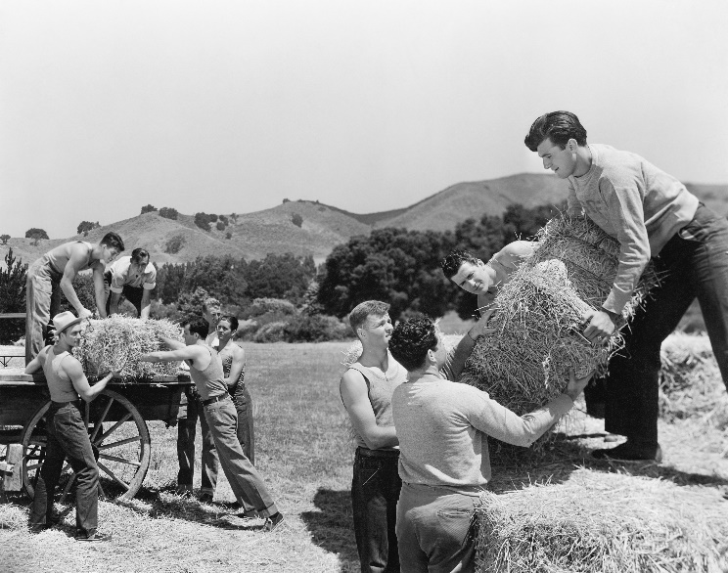
Narratives and identity: Exercise
Narratives
to understand the world
to know how to behave in it
culturally instructive
Source: www.shutterstock.com
“Hard work and self-reliance our virtues”
Notes:
Instructions / suggested text sheet 21
So narratives have a neutral to positive function in that they help us to understand the world and know what to do in certain contexts. This earns respect and appreciation within our (sub)culture.

Slide 23
Narratives and identity: Exercise
Narratives
to understand the world
to know how to behave in it
culturally instructive
Narratives can also be a
push factor for radicalisering
pull factor for radicalisering
Notes:
Instructions / suggested text sheet 22
Some narratives are empowering or instructive, others exclude, dehumanise or evoke hatred. And those can be become a push or pull factor for radicalisation
@Trainer, background info from D3.2.4
Scientific studies of factors of radicalisation cite troubled and conflictual identities among the most frequently pull factors: a sense of identity described as a ‘quest for significance’ (A. W. Kruglanski 2014), ‘search for identity contributing to a sense of belonging, worth and purpose’ (Dalgaard-Nielsen 2008b), personal fulfilment (Silverman 2017), lack of self-esteem (R. &. Borum 2017) (Chassman 2016) (Christmann 2012) (Dawson 2017) (Lindekilde 2016) (Senzai 2015), individual frustration and insult (Larry E. Beutler, Psychology of terrorism 2007 ), cognitive-social factors like risk taking and reduced social contact (M. &. Taylor 2006), personal victimization (C. &. McCauley 2011), displacement of aggression (Moghaddam 2005), are all related to a conflictual and dysfunctional sense of identity.

Slide 24
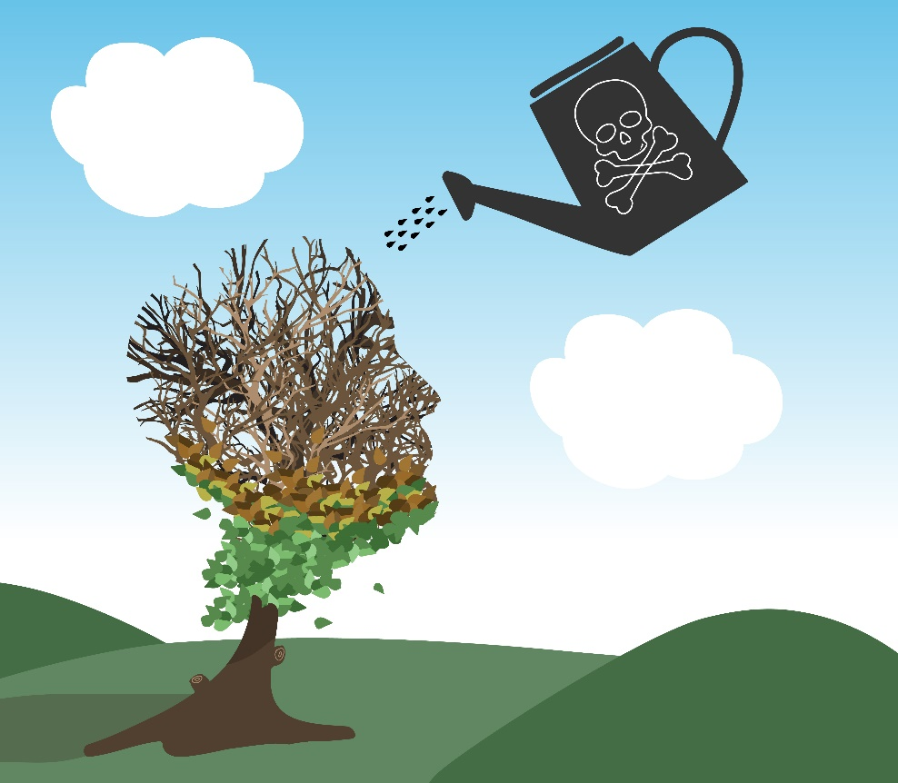
Toxic narratives
evoke
Fear
Rejection
Hate
Notes:
Instructions / suggested text sheet 23
A toxic narrative is a narrative that primarily evokes fear, rejection or even hate leading to conflicting or dysfunctional narratives of self and others
Any story that disempowers the individual, reduces him to a narrow set of values and stirs negative emotion is set to have a negative effect.
Source picture: https://www.insightswb.com/wp-content/uploads/2017/01/plant.jpg

Slide 25
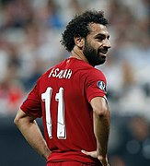
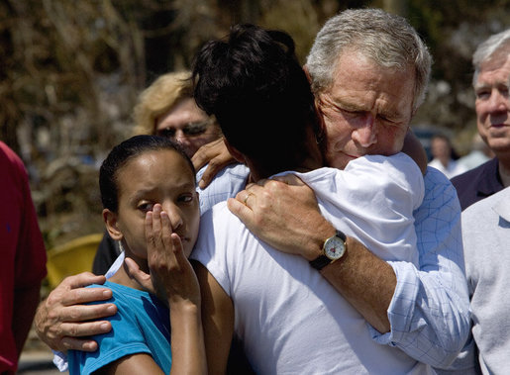
Narratives
Sadiq Khan
Image credit: Shayan Barjesteh van Waalwijk van Doorn via commons.wikimedia.org/
REAL MEN DON’T CRY
BRITISH
FEMALE
MUSLIM
GAY
Serena Williams
Image credit: Hanson K Joseph via commons.wikimedia.org
Mohamed Salah
Image credit: Fars News Agency via commons.wikimedia.org
George Bush
Image credit: White House photo by Eric Draper
Trevante Rhodes speaking at the 2018 San Diego Comic Con International
Image credit: Gage Skidmore via commons.wikimedia.org
Notes:
Instructions / suggested text sheet 24
https://medium.com/@robertocarlosgarcia/men-dont-cry-on-toxic-masculinity-6e7917c8a44e
Other examples of the implicit instructions are the next images.
They often give an image and an opinion about certain groups and subcultures such as gender, sexual organisation, cultures.
Click
But isn’t George Bush also a man?
Can’t Sadiq Khan be British?
Is it ok for a woman to be muscular?
Isn’t he a Muslim?
Can’t he be gay?
@Trainer: background info on the pictures
Then-President George W. Bush tears up during a ceremony to present the Medal of Honor posthumously to Navy SEAL Petty Officer Michael Monsoor.
Sadiq Khan is a British citizen of Pakistani descent, he is a politician, a lawyer and he is mayor of London since 2016
Mayor of London Sadiq Khan addresses supporters of the “Britain Stronger In Europe” movement in west London on May 30.
Serena Williams is an American professional tennis player, who has won 23 Grand Slam titels. She is often mocked for her muscular physique, for not being feminine enough. Serena Williams reacts after defeating Bethanie Mattek-Sands during their Women's Singles Third Round match of the 2015 US Open.
Mohamed Salah is an Egyptian professional soccer player, currently playing for Liverpool FC. He is Muslim. Salah, a club record signing from Roma this summer, celebrates after scoring for his new Liverpool side after 20 minutes.
Actor Trevante Rhodes plays Chiron, a gay African-American man growing up in the ahrsh world of the ghetto, in a beautiful movie about identity, narratives and choices . Trevante Rhodes plays African-American gay man in ‘Moonlight’ (2016)

Slide 26
Workshop on narratives and identity
Who
First line practitioners
What
Framework radicalisation
Exercises and simulations
How
Knowledge
Practice skills
Result
Recognising signs
Deal with dysfunctional narratives
Notes:
Instructions / suggested text sheet 25
How can practitioners help youths to deal wit toxic narratives? The workshop that is offered in this project is meant to support them in doing so.
It is meant for first line practitioners like teachers, social workers, police officers, mentors, psychologists etc.
‘The Narrative and Identity’ workshop delivers a framework, scenario, and detailed set of exercises and simulations that can assist participants in understanding the role narratives play in our identity formation, the way they can spot dysfunctional or toxic narratives and, last but not least, the way in which they can use narratives in order to employ promising psychoeducational intervention practices in their professional daily routine. It comprises a series of exercises that, if used in convergence, can help first line professionals use narrative therapy strategies and techniques to help divert young people from a negative image of self and others. It also offers solutions to encourage in young people positive and empowering ways of self-expression and self-affirmation. The techniques described have been inspired by the work of therapists using narrative therapy in treatment of phobias, anxiety, depression, schizophrenia etc.
From D3.2.4
The lab proposes techniques that help teach young individuals respond to negative stimuli and toxic narratives in concrete situations. It equips professionals involved in interaction with young people with solutions to encourage them how to control behaviour by reframing their identity and image about self, empowering own positive choices. The aim is to teach first line professionals address young people vulnerable to radicalisation by responding to their needs in non-destructive ways and making them resilient to conflicts while adopting a sense of personal value.
For more detailed information I recommend the Manual for trainers of the Workshop Narratives and identity (show the site where it can be found? Or give a printed version as a gift?)
We will now take an example of possible exercises from the workshop

Slide 27
Narratives and identity: Exercise 2
What struck you?
Make groups of 3, 4 or 5
Reflect on the meaning
Choose form
Share your story within group
Who am I?
Notes:
Instructions / suggested text sheet 26
This is an example of one of the exercises in the workshop Narratives and Identity
Make groups of 3, 4 of 5
Let them choose if they would like to use the form for 12-16 yr old or the one for 16+
Answer the question “Who am I?” by using form 2 or 3. Be aware there is a form for younger children
Group discussion: reflect on the value of the personal story, its positive / negative tone, how the selection of storied events was made, and what kind of cultural filters we apply.
Round up 2 minutes discussion: What struck you in the exercise / the trainer collects possible answers on a flipchart.

Slide 28
Narratives and identity: Exercise 2
Who am I?
objective
instructions
target audience
duration
Notes:
Instructions/text sheet 27
The exercise is named Who am I?
Ask participants: What do you think about the idea behind this exercise?
The objective is to let participants experience their own narrative and the influences that shaped it, also to get a preliminary scan on participants beliefs and knowledge on narratives from a social sciences perspective
Each workshop comes with a manual that describes the objective, target audience and timing of each exercise. Also instructions are given about the execution and materials needed for the exercise.
Who am I?
Objective
To let participants experience their own narrative and the influences that shaped it
Target audience
Any (if adapted to target group audience level of understanding)
3 distinct exercise handouts are offered: beginner (recommended for age: 6+12), intermediate (recommended for age: 12-16+), and advanced (recommended for age 16+/adults
Timing
45 min
Description
Step 1: Make groups of 3, 4 of 5 Let them choose if they would like to use the form for 12-16 yr old or the one for 16+
Answer the question “Who am I?” by using form 2 or 3. Be aware there is a form for younger children
Group discussion: reflect on the value of the personal story, its positive / negative tone, how the selection of storied events was made, and what kind of cultural filters we apply.
Round up 2 minutes discussion: What struck you in the exercise / the trainer collects possible answers on a flipchart.
Learning method
Learning by doing demonstration and guided discussion

Slide 29
Debate and simulation
Knowledge
Critical thinking
Res
i l ience
Skills
Communication
Values
Cooperation and empathy
Attitudes
(Self) reflection
Notes:
Instructions / suggested text sheet 28
Our next workshop is about the ability to enter a discussion or debate in a constructive way.
The knowledge, skills, values and attitudes learnt during the workshop dedicated to simulation and debate are meant to facilitate resilience building to extreme ideologies and violent behaviour, by consolidating critical thinking, communication, cooperation, empathy, and (self) reflection.
This workshop will have no impact if implemented only once. The debate-based workshop should take place regularly.
From D3.2.5
Teaching simulation and debate serves the purpose of developing knowledge and skills through the cognitive behavioural instructional model and the learning by doing model. It is also a form of psychoeducational intervention in which the moderator of the debate functions as a coach ready to offer replicable strategies of positive self-expression and goal-oriented communication while also fostering tolerance and open minded assessment of other people’s adverse opinions.
knowledge, skills, values and attitudes learnt during the workshop dedicated to simulation and debate are meant to facilitate resilience building to extreme ideologies and violent behaviour, by consolidating critical thinking, communication, cooperation, empathy, and (self) reflection
we believe simulation debate as a psycho-educational intervention method, has the potential to increase resilience to push and pull factors of radicalization such as: a sense of identity described as a ‘quest for significance’, ‘search for identity contributing to a sense of belonging, worth and purpose’ , personal fulfilment, lack of self-esteem, individual frustration and insult , cognitive-social factors like risk taking and reduced social contact, personal victimization, displacement of aggression, are all related to a conflictual and dysfunctional sense of identity.
Although debate and simulation games have been widely used in academic contexts, including as learning instruments, the EL differs from a regular debate training in the sense it does not aim to equip the participants with the necessary knowledge and skills to be a part of a debate, but rather to understand its purpose, structure and the context in which it can be employed, as well as. methodological constraints and loose ends

Slide 30
Workshop on debate and simulation
Who
First line practitioners
What
Framework radicalisation
Exercises and simulations
How
Knowledge
Practice skills
Result
Recognising signs
Debating skills
Notes:
Instructions / suggested text sheet 29
How can first line practitioners help youths to develop debating skills? The workshop that is offered in this project is meant to support them in doing so.
For more detailed information I recommend the Manual for trainers of the Workshop Anger Management (show the site where it can be found? Or give a printed version as a gift?)
We will now take an example of possible exercises from the workshop

Slide 31
The middle ground
"Black and white thinking is when you believe that your story is the only truth“
Babah Trawally
Beyond black and white thinking
Notes:
Instructions / suggested text sheet 30
Click on #Dare to be grey
One of the underlying goals is to realise that black or white opinions are not the only ones, and that you do not have to ‘pick sides’, you can have a nuanced, ‘grey’ opinion. Dare to be grey is a project that aims to oppose online and offline polarization by amplifying opinions of the ‘grey middle’. Campaigners, data analysts and social workers join hands to combat polarization and the processes of radicalization that stem from it.
https://projectgrey.eu/
https://youtu.be/WPChHeKaurQ
CO: This sheet could also fit Critical Thinking

Slide 32
Debate and simulation: Exercise 1
Killing is always wrong
Statement is true
When is it false?
Share one example
Last one with new case wins
OPTION
Notes:
Instructions / suggested text sheet 31
This is an example of one of the exercises in the workshop Debate and simulation. Again, my suggestion is to first experience how the exercise goes and then discuss the objectives
@Trainer
This exercise takes about 40 minutes (depending on the amount of statements and participants)
Step 1: Inform students that they will listen to statements which are always true
Step 2: Their job is to think of as many cases/situations where the statement is false, and to make their own lists.
Step 3: Go around the group asking for one example from each student; if a student gives an example that has already been mentioned, they have one minute to think of another.
Step 4: If the student fails to think of a new example, they are out of the game. The teacher keeps asking each student in turn until only one student has examples left on their list.
Step 5: At the end of the exercise, 15-20 minutes should be allotted to group discussion concerning the ideas expressed and what consequences do they entail (today it can be a short round)
The statement could be ‘killing is wrong’
Another one could be ‘???

Slide 33
Debate and simulation: Exercise 1
True or false?
objective
instructions
target audience
duration
Notes:
Instructions/text sheet 32
The exercise is named True or false?
Ask participants: What do you think about the idea behind this exercise?
Each workshop comes with a manual that describes the objective, target audience and timing of each exercise. Also instructions are given about the execution and materials needed for the exercise.
True or false
Objective
• To help improve lateral thinking skills
• To help improve rebuttal skills
• To encourage quick thinking skills
• To encourage memory skills
• To improve vocabulary and word usage
• To encourage listening skills
• To encourage peer assessment
Target audience
puberty/teenage/adult
Timing
15-45 min (depending on the amount of statements and the size of the group)
Description
Step 1: Inform students that they will listen to statements which are always true
Step 2: Ask them to think of as many cases where the statement is false, and to make their own lists.
Step 3: go around the group asking for one example from each student; if a student gives an example that has already been mentioned, they have one minute to think of another.
Step 4: If the student fails to think of a new example, they are out of the game. The teacher keeps asking each student in turn until only one student has examples left on their list.
Step 5: At the end of the exercise, 10-15 minutes should be allotted to group discussion concerning the ideas expressed and what consequences do they entail (today it can be a short round)
Learning method
Extended practice, guided discussion, covert self-instruction (student inner speech)

Slide 34
Feedback
Exercises
How do I know I am angry?
Wheel of emotions – hints
Make a plan!
Spot the problem (Chimamanda Adichie)
Who am I?
True or false?
FEED
FEED
BACK
Notes:
Instructions / suggested text sheet 33
In this secon session of the TTT, we introduced three workshops of project ARMOUR, on Anger Management, Narratives & Identity and Debate & simulation
Distribute T2 survey day 2.
Explain that participants can use the number of the exercise as shown to add comments on a specific exercise
Did they help you get to grips with the concepts?
Are they useful for use with young people?
Which ones are useful in your work (or privately)?
Next time we will look at Conflict handling and State response as contributing factors in radicalisation

Slide 35
А question for the next time
See if you encounter situations to which you can apply what you’ve learned so far
Notes:
Instructions / suggested text sheet 34
For the next day I would like you to …

Slide 36
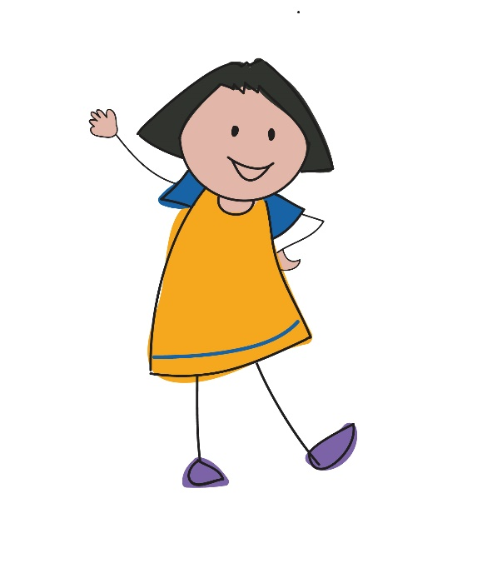
Conclusion
What was most interesting to you today?
What was most interesting to you today?
Notes:
Instructions / suggested text sheet 35
@Trainer: Make a round and collect highlights
The rationale behind this is to end with a positive and to reinforce these particular topics

Slide 37
Thank you!

