Slide 1
Train the Trainer
Session 3: Preventing Youth Radicalisation
Notes:
Instructions / suggested text sheet 0
Welcome back (check if attendance list is signed by all participants)
@Тrainer (see manual for further instructions)
Needed
Attendance list
Laptop/PC en beamer
Pens and paper for participants
Flip over
markers, cards, puzzle, white paper sheets, scissors, *smartphones to access Pauliseverywhere.
internet access,
Handouts exercises ( )
Surveys
Suggested planning day 3 (depending on your choice of exercises)
Walk-in, coffee, tea 15 min
Introduction 45 min
Explanation radicalisation 45 min (depending on initial knowledge, this can be extended or shortened)
Break 15 min
Relation between Anger and radicalisation 45 min
Exercise(s) Anger management 60 min
Lunch 60 min (take time for exchange of experiences and building network if possible)
Relation narratives 30 min
Exercise(s) Narratives 45 min
Break 15 min
Exercise(s) Narratives 30 min
Feedback and conclusion 15 min
Totaal ruim 6,5-7 uur, met een half uur speling zou je kunnen beginnen om 09.00 en plannen tot 16.30 uur PM.

Slide 2
Recap of Day 2
1
7 workshops
Individual capacity building
Coaching and parenting
Critical thinking
Community capacity building
State response
Anger management
Narratives and identity
Debating and simulation
Conflict management
Proportionate state response
1. How do I know I am angry?
2. Wheel of emotions – hints
3. Make a plan!
Recap of Day 1
Anger management
incl. Exercises
Narratives and identity
incl. Exercises
Simulation and debate
incl. Exercises
Feedback
Conclusion
Understanding radicalization in general
Relation between radicalisation and specific topic
Clarification specific topic
Exercises
1. Spot the problem
2. Who am I?
“a phased and complex process in which an individual or a group embraces a radical ideology or belief that accepts, uses or condones violence [ ] to reach a specific political or ideological purpose.”
1. True or false?
Notes:
Instructions/text for sheet 1
Start with a rehearsal of last time. Take some time because it stimulates memory and activates the participants, and it lays a better foundation for day 3.
You can show the selected summary pictures to jog their memory, but better to just let them tell you the content
(NB this sheet looks chaotic, but if you ‘play’ it, it will be clear)
What did we do last time? What do you remember?
We shortly repeated the content of day 1. Especially the overview of the workshops and the definition of radicalisation
Anger Management – what is anger and, how can anger can fuel radicalisation and how to deal with it in a more constructive way
Exercises– experimenting with exercises to help youth to manage their anger
Narratives– explanation on the way narratives can either increase the chances of radicalisation (via its effect on identity)
Exercises– experiencing one or more of the exercises understand the impact of narratives and/or how to use it in a more positive way
Simulation and discussion
Exercise-
Feedback – your feedback on the exercises of the second day

Slide 3
Question
1
See if you encounter situations to which you can apply what you’ve learned so far
Notes:
Instructions/text for sheet 2
Before we move on to today’s programme, I would like to get back to the question I asked if you at the end of the second session.

Slide 4
Today’s programme
1
Recap of Day 2
Conflict resolution
incl. Exercises
Proportionate state response
incl. Exercises
Best practices
Feedback
Conclusion
Notes:
Instructions/text for this sheet 3
Recap – shortly rehearse content of day 2 and concept of radicalisation (for better memorisation and foundation of day 3)
Conflict handling – explain how the inability to deal with conflictual situations can boost radicalisation
Exercises – to practice conflict handling
State response – explain how the way the government responds to situations can either increase or decrease radicalisation
Exercises – to understand how the response of the state should be for a positive effect on radicalisation
Best practices – to show you more sources of information and practices
Feedback – your feedback on the exercises of day 3 and the training as a whole
Conclusion – some final remarks on the programme

Slide 5
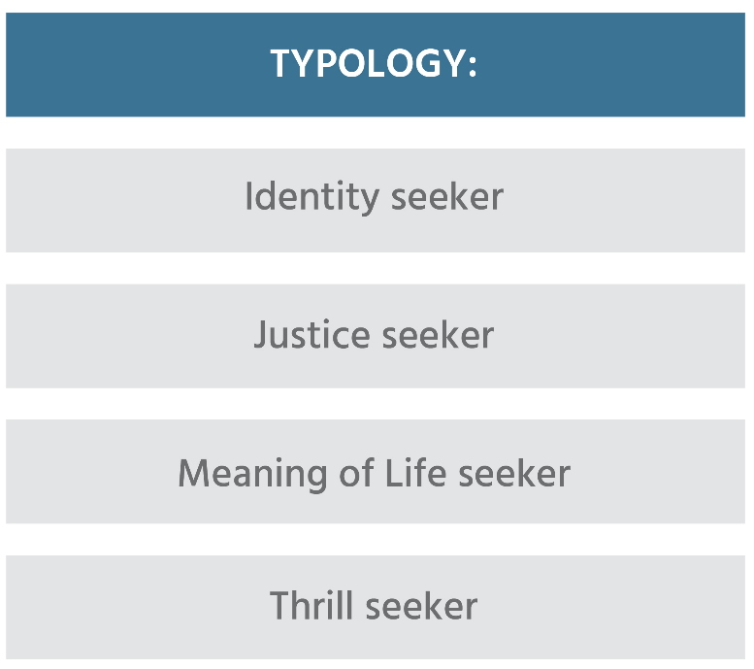
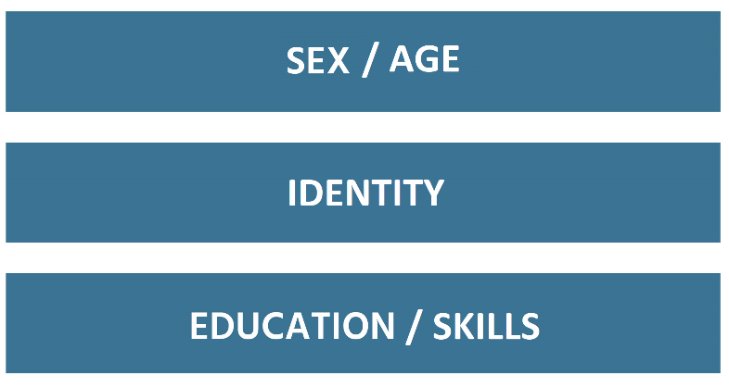
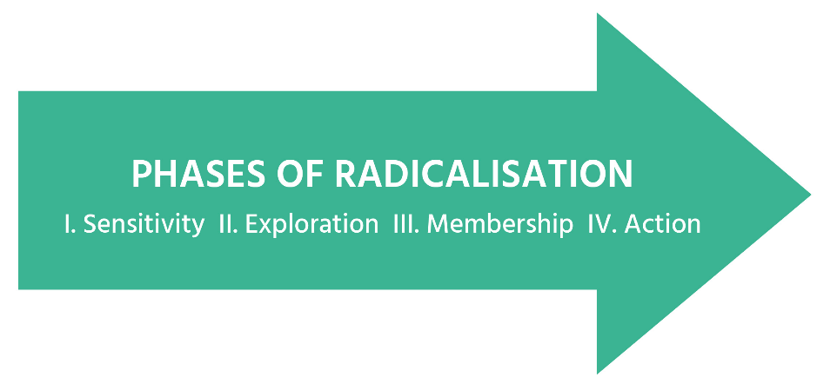
2
Personal experience with discrimination
Problems at home
Confrontation w. death
Confrontation with propaganda
Part of radical group
Injustice against group
Calls to action
Government policy
War against group
Notes:
Instructions/text for sheet 4
The first day we ended our exploration of radicalisation with the trigger factor model which described several components of radicalisation in their interaction.
(@Trainer: If you have different participants, it might be beneficial to explain this model (see slide session 1). If you have the same participants, you can simplify this slide by removing all animations, except for animations 11-13)
And we saw how the workshops in this project tie in with many of the mentioned factors and characteristics.
Today we will continue with two other contributing factors of radicalisation: conflict handling and proportionate state response.
Skills: e.g. conflict management
Government policy: proportionate state response
Propaganda: from local and national politicians

Slide 6
Ice breaker
2
What struck you?
How do I recognise a conflict?
Discuss in twos
What events/people/topics/ situations often create conflict?
How does my reaction solve the problem?
How do I react when I’m in a conflict?
Notes:
Instructions/text for sheet 5
We will start with an icebreaker from the workshop conflict handling. Please take a paper and pen (or tablet/smartphone/laptop).
@Trainer
This exercise is one of the icebreakers in the workshop on Conflict Handling. It takes about 15-20 minutes
Step 1-4: Trainer asks participants to answer the following questions (one by one) by writing no more than three words per question on a sheet of paper. (4 min)
“How do I recognize a conflicting communication situation?”
“What events/people/situations /discussion themes create conflict most often?”
“How do I react when I end up in a conflict with another person/group of people?”
“How does my conflict resolution strategy manage to solve the problem?”
Step 5: each participant chooses a partner and shares answers with him/her. (4 min) [on-line, this could be done with a short break-out session, if the platform allows it. Otherwise skip this step]
Step 6: a 2 minutes roundup discussion is used by the trainer to collect possible answers on a flipchart. Hopefully, the observations of the participants point to the objective of this exercises: to become aware of one’s personal way of experiencing and dealing with conflict, and to be able to recognise it. People become aware that conflicts are something we are all familiar with.
Trainer closes the ice breaker by pointing at the most common answers and continue by pointing out that:
From D3.2.6
Conflict is a normal component of human relationships, and it does not necessarily have to be regarded as a negative aspect. When handled constructively, conflict can bring positive results in a relationship, no matter the type. The way conflict is handled determines whether it is constructive or destructive.

Slide 7
Conflict and radicalisation
2
Frustration
Lack of self-esteem
Push factors towards radicalisation
Victimisation
Reduced social contact
Anger
Notes:
Instructions/text for sheet 6
From D3.2.6
Several factors are often cited as push factors for radicalisation, among them:
the emotion of anger and displacement of aggression
lack of self-esteem,
individual frustration and insult,
personal victimization
cognitive-social factors like risk taking and reduced social contact
Therefore we assess that conflict resolution is a skill that, if correctly internalised and applied in daily life, can only consolidate the set of protective factors and a sense of resilience to radicalisation and violent extremism.
The present deliverable will, therefore, provide the curricula and content of the experimental lab dedicated to conflict resolution techniques that can be used by first line practitioners in order to assist children and young people, which are often pushed by tense interactions with family members and peers, in strengthening their resilience to polarization and radicalization.
When teens resolve conflicts constructively, interact with others in a positive manner, are open to differences between people, are confident in the knowledge of who they are, what they think and believe, why they make certain choices, and are able to ask questions to enhance this understanding, they are more likely to be able to resist deceptive messaging and make informed, safe choices.
The strategies and techniques of conflict resolution, offered in the workshop Conflict resolution, can be used by educators, coaches and therapists in teaching and promoting positive and constructive ways of resolving conflicts.

Slide 8
Conflict resolution skills
2
Assertiveness
Emotional awareness
Cognitive empathy
Active listening
Notes:
Instructions/text for sheet 7
From D3.1.7
teaching adolescents to apply constructive conflict resolution techniques provides them the necessary toolkit in order to develop healthy conflict styles so that they can maintain healthy relationships with family, friends/ colleagues, and ultimately, avoid social polarization and other co-related issues like radicalisation.
The main skills teenagers should master as a part of a healthy emotional development are as follows:
1. Assertiveness is one of the most important skills in handling conflicts. The ability to express one’s views clearly and firmly, but without aggression is key in preventing or dealing with conflicts in a responsible manner. Assertive communication can strengthen relationships, reduce stress from conflict and provide the social support when facing difficult times.
2. Emotional awareness refers to understanding oneself and others, knowing one’s feelings in order to communicate effectively or smooth over disagreements. One particular part of emotional intelligence which is useful in conflict resolution is empathy.
3. Cognitive empathy is the ability to understand how a person feels and what they might be thinking. Cognitive empathy makes people better communicators, because it helps them relay information in a way that best reaches the other person.
4. Active listening to the counterpart’s concerns is one of the most important conflict negotiation strategies one can adopt. Listening and asking questions aimed at drawing out the other party’s core issues, instead of defending oneself, can give a sense of the other person’ s perspective.
From D3.2.6
Emotional empathy, also called affective empathy or primitive empathy, is the subjective state resulting from emotional contagion. It is our automatic drive to respond appropriately to another’s emotions. This kind of empathy happens automatically, and often unconsciously. It has also been referred to as the vicarious sharing of emotions.
Cognitive empathy is the largely conscious drive to recognize accurately and understand another’s emotional state. Sometimes we call this kind of empathy “perspective taking.” Cognitive empathy is deliberate, a skill that everyone at work can learn and needs to use.

Slide 9
Workshop on conflict resolution
2
Who
First line practitioners
What
Concept of radicalisation
Exercises
How
Knowledge
Practice skills
Result
Recognising signs
Conflict handling skills
Notes:
Instructions/text for sheet 8
How can first line practitioners help youths to develop conflict handling skills? The workshop that is offered in this project is meant to support them in doing so.
It provides a framework, scenario, and detailed set of exercises and simulations that can assist participants in learning how to support youths in dealing with conflicts.
Conflict resolution is a form of psycho-educational intervention in which the teacher, counsellor, or any person of influence and legitimate authority for the target group can advise, promote and assist participants in internalizing the skills necessary for positive resolve of tensed situations and conflicts. This form of intervention creates the premises for behavioural change while offering a safe space to exercise new ways of handling tensed and conflicting situations and social interactions.
The curricula and content of the workshop should be used in direct correlation with the support material provided in Deliverable D3.1.6.
For more detailed information I recommend the Manual for trainers of the Workshop Conflict Handling (show the site where it can be found? Or give a printed version as a gift?)
We will now take an example of possible exercises from the workshop

Slide 10
Conflict resolution: Exercise 1 (1)
2
Stage 1
Nothing, something, anything!
Followed by name of any item
Why is yours the best?
Debate or dialogue?
OPTION
Notes:
Instructions/text for sheet 9
The workshop Conflict resolution offers a selection of exercises to teach relevant skills to youths
Here is an example of one of them.
@Trainer
This exercise takes about 30 minutes in total [I don’t see a good way to do this exercise on-line. Maybe provide each pair with two words and then have them debate why theirs is better in a break out session? Anyone else ideas?]
[Since the icebreaker is also from this workshop, we could just explain the exercise on sheets 10-13 (called Anything goes) to the participants]
Stage 1
Step 1: Ask participants to find a partner.
Step 2: Have each pair stand face to face, right fist out (as in Rock, Paper, Scissors), and say together, “Nothing, something, anything!” .
Step 3: Once the word anything is said, the two participants yell out the name of any item they can think of (dog, coffee mug, shoe).
Step 4: After yelling out their items, team members must now debate one another as to why their item would “beat” the other person’s item. Allow about two or three minutes of debate.
Step 5: Call a brief time-out to initiate a preliminary discussion about the difference between debate and dialogue. To make the distinction, recall the definitions of active listening and cognitive empathy and, using handouts in Fig. 2 and Fig. 3, ask each student to check out how many of the conditions of dialogue were met.
Cognitive empathy is the ability to understand how a person feels and what they might be thinking. Cognitive empathy makes people better communicators, because it helps them relay information in a way that best reaches the other person.
Active listening to the counterpart’s concerns is one of the most important conflict negotiation strategies one can adopt. Listening and asking questions aimed at drawing out the other party’s core issues, instead of defending oneself, can give a sense of the other person’ s perspective.
In dialogue, the intention is to really listen to one another’s perspective with a willingness to be influenced by what we hear. Dialogue allows people to develop understanding for one another’s perspectives, thoughts, and feelings as well as to re-evaluate their own position in light of the other’s understanding. In dialogue, everyone has a chance to be heard, understood, and to learn from each other.

Slide 11
Conflict resolution: Exercise 1 (2)
2
Stage 2
Continue conversation
Engage in dialogue
Ask questions and listen actively
Agreement
OPTION
Notes:
Instructions/text for sheet 10
The exercises continues
@Trainer
This exercise takes about 30 minutes in total
Stage 2
Step 1: After the preliminary discussion, have the team continue with their conversations, only now, encourage team members to engage in dialogue—asking questions and listening to the answers—to come to an agreement between the two of them.

Slide 12
Conflict resolution: Exercise 1 (3)
2
Stage 3
In pairs
Answer discussion questions
Switch
What struck you?
OPTION
Notes:
Instructions/text for sheet 11
The third part of the exercise
@Trainer
This exercise takes about 30 minutes in total
Stage 3 - Wrap up discussion
Step 1: Distribute handout with Discussion Questions
Step 2: In pairs, one person starts, walk through each question
Step 3: Switch
Discussion questions:
1. How did you react to your mini conflict?
2. Is this how you normally act in conflict situations? Why or why not?
3. How were you able to come to a consensus?
4. What happened when you switched from debate to dialogue?
5. When someone disagrees with you, do you always stop to ask questions?
6. Is it difficult to listen when someone disagrees with you? Why?
7. What made it easier in this activity?
8. In what ways could you use these skills the next time you’re in conflict with another person?

Slide 13
Conflict resolution: Exercise 2
2
Anything goes!
objective
instructions
target audience
duration
Notes:
Instructions/text for sheet 12
The exercise is named Anything Goes!
Ask participants: What do you think about the idea behind this exercise?
Each workshop comes with a manual that describes the objective, target audience and timing of each exercise. Also instructions are given about the execution and materials needed for the exercise.
Anything Goes!
Objective
This game is a great way for participants to engage in a mini-conflict with another team member in a nonthreatening manner. Participants will learn how to make the difference between debate and true dialogue.
Target audience
puberty/teenage/adult
Timing
30 min
Description
Stage 1
Step 1: Ask participants to find a partner.
Step 2: Have each pair stand face to face, right fist out (as in Rock, Paper, Scissors), and say together, “Nothing, something, anything!” .
Step 3: Once the word anything is said, the two participants yell out the name of any item they can think of (dog, coffee mug, shoe).
Step 4: After yelling out their items, team members must now debate one another as to why their item would “beat” the other person’s item. Allow about two or three minutes of debate.
Stage 2
Step 1: Call a brief time-out to initiate a preliminary discussion about the difference between debate and dialogue. To make the distinction, recall the definitions of active listening and cognitive empathy and, using handouts in Fig. 2 and Fig. 3, ask each student to check out how many of the conditions of dialogue were met.
Stage 3 - Wrap up discussion
Discussion Questions
1. How did you react to your mini conflict?
2. Is this how you normally act in conflict situations? Why or why not?
3. How were you able to come to a consensus?
4. What happened when you switched from debate to dialogue?
5. When someone disagrees with you, do you always stop to ask questions?
6. Is it difficult to listen when someone disagrees with you? Why?
7. What made it easier in this activity?
8. In what ways could you use these skills the next time you’re in conflict with another person?
Learning method
Guided discussion, rehearsal in pretend scenarios, cognitive modelling through mentor think aloud, covert self-instruction, teamwork

Slide 14
3
Personal experience with discrimination
Problems at home
Confrontation with death
Confrontation with propaganda
Part of radical group
Injustice against group
Calls to action
Government policy
War against group
Notes:
Instructions/text for sheet 13
For our next topic we go back to the trigger factor model which described several components of radicalisation.
We will now focus on the way the government responds to certain situations and the effect it can have on radicalising youths
It may sometimes come across as injustice against a group, both on a local as on a more distant national or international level

Slide 15
Proportionate state response
3
Frustration
Social exclusion
Push factors towards radicalisation
Victimisation
Perception of injustice
Anger
Notes:
Instructions/text for sheet 14
Coming back to the earlier set of push factors (with lack of self-esteem replaced by social exclusion and reduced social contact replaced by perception of injustice) it is easy to see how a disproportionate response can feed into many of the factors mentioned.
From D3.2.7
Several studies have shown that a perception of injustice represents one of the strongest factors driving radicalization. Considering the results of these studies and, in order to avoid radicalization, it becomes necessary to provide detailed guidelines to practitioners about what are the appropriate boundaries for state action.
An analysis of case studies available in the field literature of the past two decades shows that too harsh a response from the state is likely to produce further radicalisation, whereas too hesitant a response can prove ineffective and allow further societal polarisation and discontent. Therefore, learning how to design and implement proportionate measures has become a necessary step forward that we need to encourage and facilitate.
From D3.1.7
While combating radicalization is crucial in order to ensure internal security, the way the state approaches this particular task is relevant for whether it successfully combats the phenomenon or it actually makes it worse. That is why establishing the proper limits of state response to the phenomenon of radicalization is relevant to implementing an acceptable policy for combating it.
While combating radicalization is crucial in order to ensure internal security, the way the state approaches this particular task is relevant for whether it successfully combats the phenomenon or it actually makes it worse. That is why establishing the proper limits of state response to the phenomenon of radicalization is relevant to implementing an acceptable policy for combating it. One of the most well-known causes of radicalization is the perception of (Neuroscience news, 2019) social exclusion. According to experiments conducted, people who felt left out by a particular social group were the most prone to radicalization. That is why the experience of abuse by the state should be limited as much as possible by the institutions charged with enforcing the law. Furthermore, cultural awareness is also crucial when aiming to prevent radicalization. According to research (Neuroscience news 2019), people distinguish between "sacred values" and "non-sacred values". They have a higher willingness to die for their sacred values than for non-sacred values and this willingness increases when these sacred values are seen as being abused by an institution of the state.
@Trainer
This workshop can be used for flps/(older) youths, so they will understand the dilemmas governmental institutions have in responding to radicalisation. But it can also be tailored towards policymakers and LEAs. Because they will be the ones affecting the way the state responds.
- The current scenarios of the State Response workshop mostly deal with religious extremists (and/or might be interpreted by participants to be dealing with radicalised Muslims, because of their biased ideas about radicalisation) and /or police abuse of power. Depending on the audience you might want to add more diverse scenario's to show we are not only dealing with these types of radicalisation and dilemmas - maybe something on environmental activism or the 5G/COVID19 or legislation.

Slide 16
Effects of state response
3
Anger
Discontent
It is ineffective
Further polarisation/ radicalisation
Security threats
Too soft
Anger
Injustice
It is ineffective
Further polarisation/ radicalisation
Too harsh
Notes:
Instructions/text for sheet 15
But the state and law enforcement have to act on security threats, on local and national levels. Both from a very practical perspective of protecting people, but also from a political perspective.
From D3.2.7
An analysis of case studies available in the field literature of the past two decades shows that too harsh a response from the state is likely to produce further radicalisation, whereas too hesitant a response can prove ineffective and allow further societal polarisation and discontent. Therefore, learning how to design and implement proportionate measures has become a necessary step forward that we need to encourage and facilitate.
From D3.1.7
While combating radicalization is crucial in order to ensure internal security, the way the state approaches this particular task is relevant for whether it successfully combats the phenomenon or it actually makes it worse. While the literature acknowledges that a state response is necessary in the case of radicalization, especially when lives are at risk, most studies (Borum 2011; Campelo et al 2018; Slootman and Tille 2006) also emphasize the fact that abusive treatment by the police represents one of the main factors that trigger or increase radicalizationThat is why establishing the proper limits of state response to the phenomenon of radicalization is relevant to implementing an acceptable policy for combating it.

Slide 17
Workshop on proportionate state response
3
Who
Policy makers
What
Concept of radicalisation
Scenarios
How
Knowledge
Debate scenarios
Result
Recognising signs
Proportionate state response
Law enforcement
Notes:
Instructions/text for sheet 16
How can policy makers contribute to preventing radicalisation? The workshop that is offered in this project is meant to support them in doing so. This laboratory uses twelve scenarios, inspired by real cases, in which the state acted in order to combat radicalization. Participants will be asked to debate whether these actions were proportional or not and to provide reasons for their claims.
The workshop aims to acquaint practitioners with the challenges posed by the interaction between law enforcement officers and people who have been potentially radicalized. While the literature acknowledges that a state response is necessary in the case of radicalization, especially when lives are at risk, most studies also emphasize the fact that abusive treatment by the police represents one of the main factors that trigger or increase radicalization.
It is meant for policy makers (local and national) and police?? etc.
It provides a framework, scenario, and detailed set of scenarios to exercise finding the right response
With this knowledge and skills participants will learn how to:
Recognise the signs of radicalisation
Find the balance in looking for an proportionate and effective state response
For more detailed information I recommend the Manual for trainers of the Workshop Critical Thinking (show the site where it can be found? Or give a printed version as a gift?)
We will now take an example of possible exercises from the workshop
CO: Is it about state response, right? Not any response? So the target group is policy makers and law enforcement? Not any practitioner, am I correct?

Slide 18
Proportionate state response: Exercise 1
3
When referring to public policies and actions:
Choosing means so as to achieve more positive than negative effects
Avoid causing unnecessary harm
What does proportionate response mean?
Don’t protect a lesser value at the expense of a more important one
The state response should be necessary and fitting to the problem
Notes:
Instructions/text for sheet 17
This is an example of an ice-breaker from the workshop Proportionate State response
@Trainer
Withold the four side text blocks until after step 3
This exercise takes about 10 minutes
Step 1: Ask participants to write down a few key words as an answer to the question 2-3 minutes
Step 2: Have them discuss their answers with another participant (3 minutes) [if online: this can be done in a break out session, or skipped]
Step 3: Ask the group about the key words they agreed on (2-3 minutes)
Make sure that in the concluding discussion the following points are mentioned:
The concept of proportionality can essentially be defined as choosing the means in such a way as to achieve better than harm when undertaking an action which might have both positive and negative effects. This means that, to act proportionally, in this context, one has to undertake a balancing of the harms and the goods that can be achieved and to choose only those means that do less harm than the good obtained.
Acting proportionally means acting in such a way as to avoid causing “superfluous injury or unnecessary suffering”.
A disproportionate action is one which “protects a less important value (e.g., property), at the expense of a more important one (e.g., life)”.
A policy that is both necessary and fitting to the aim it wants to achieve.

Slide 19
Proportionate state response: Exercise 1
3
What is proportionate?
objective
instructions
target audience
duration
Notes:
Instructions/text for sheet 18
The scenario is named What is proportionate?
Ask participants: What do you think about the idea behind this exercise?
Name exercise
“What is proportionate?“
Objective
“To get a preliminary scan on participants' beliefs and knowledge on proportionality.“ Also, to get to a shared definition
Target audience
adult
Timing
10 min
Description
Step 1: Ask participants to write down a few key words as an answer to the question 2-3 minutes
Step 2: Have them discuss their answers with another participant 3 minutes
Step 3: Ask the group about key words they agreed on (2-3 minutes)
Make sure that in this concluding discussion the following points are mentioned:
The concept of proportionality can essentially be defined as choosing the means in such a way as to achieve better than harm when undertaking an action which might have both positive and negative effects.
To act proportionally, in this context, means to undertake a balancing of the harms and the goods that can be achieved and to choose only those means that do less harm than the good obtained.
Acting proportionally means acting in such a way as to avoid causing “superfluous injury or unnecessary suffering”.
A disproportionate action is one which “protects a less important value (e.g. property), at the expense of a more important one (e.g. life)”.
A policy that is both necessary and fitting to the aim it wants to achieve.
Learning method
Guided discussion, covert self-instruction (student inner speech)

Slide 20
Proportionate state response: Scenario 1
3
Read case
Arguments it was proportionate
Were the actions of the school and police proportionate?
Arguments it was disproportionate
Notes:
Instructions/text for sheet 19
We will now continue with one of the cases that can be used in the workshop Proportionate state response. (Case Compulsory schooling)
@Trainer
- If the compulsory schooling case does not fit your audience, choose a case that is more relevant to them (see e.g. case on slide 22), you can also tweak details about the threat to make it more challenging
- if necessary divide into several groups of maximum ten persons
- this exercise takes 40-60 minutes
Step 1: Divide group(s) into two teams [online: start with…]
Step 2: Distribute text
Step 3: Ask one half of each group to note arguments to illustrate the actions were proportionate, and the other have to note arguments to show they were disproportionate
[OR ask every participant to note arguments to illustrate the actions were proportionate, and also arguments to show they were disproportionate]
Step 4: Ask participants to share an argument (that is not mentioned before). Cluster them on a flip over (arguments for, arguments against)
Step 5: Let group discuss which arguments are deciding in coming to a group conclusion. Make sure the effects of the actions are taken into account.

Slide 21
Proportionate state response: Scenario’s
3
What is proportionate?
objective
instructions
target audience
duration
Notes:
Instructions/text for sheet 20
The scenario is named Scenario Compulsory Schooling: was this proportionate?
Ask participants: What do you think about the idea behind this exercise?
Each workshop comes with a manual that describes the objective, target audience and timing of each exercise. Also instructions are given about the execution and materials needed for the exercise.
Name exercise
“Was this proportionate?“
Objective
The goal of the exercise is to acquaint practitioners with debate around the proportionality of state actions (depending on the scenario chosen). It is also a way to learn how to balance between different kinds of positive and negative effects of certain responses
Target audience
adult
Timing
40-60 min
Description
Step 1: Divide group(s) into two teams
Step 2: Distribute text
Step 3: Ask one half of each group to note arguments to illustrate the actions were proportionate, and the other have to note arguments to show they were disproportionate
[OR ask every participant to note arguments to illustrate the actions were proportionate, and also arguments to show they were disproportionate]
Step 4: Ask participants to share an argument (that is not mentioned before). Cluster them on a flip over (arguments for, arguments against)
Step 5: Let group discuss which arguments are deciding in coming to a group conclusion. Make sure the effects of the actions are taken into account.
Learning method
Critical reading and debate

Slide 22
Proportionate state response: Scenario 2
3
Read case
Arguments it was proportionate
Were the actions of the police proportionate?
Arguments it was disproportionate
Notes:
Instructions/text for sheet 21
This is an alternative case from the workshop Proportionate state response. (Case Lethal police force)
@Trainer
- If people are interested and you have time you can choose to do a second scenario or replace the first with this one
- If the Case of the use of lethal force does not fit your audience, choose a case that is more relevant to them, you can also tweak details about the threat to make it more challenging
- if necessary divide into several groups of maximum ten persons
- this exercise takes 40-60 minutes
Step 1: Divide group(s) into two teams
Step 2: Distribute text
Step 3: Ask one half of each group to note arguments to illustrate the actions were proportionate, and the other have to note arguments to show they were disproportionate
[OR ask every participant to note arguments to illustrate the actions were proportionate, and also arguments to show they were disproportionate]
Step 4: Ask participants to share an argument (that is not mentioned before). Cluster them on a flip over (arguments for, arguments against)
Step 5: Let group discuss which arguments are deciding in coming to a group conclusion. Make sure the effects of the actions are taken into account.

Slide 23
Scenario Lethal police force
A law enforcement agency receives intelligence that a group of radicalized young people plans to commit a terrorist act which has the potential of harming many people. Four of them are tracked loading an explosive device in a car and departing towards an unknown destination.
They evade surveillance during the trip but they are re-identified by surveillance teams within two hours. At this point, they are driving a different car from the one they were seen loading the explosive devices in.
The authorities do not plan to intercept them by regular police, but by specially trained, military-like troops, which have previously been used in war zones and are trained to shoot to kill. The troops are given relatively wide rules of engagement which allow them to open fire if they believe there is a threat to life and can avoid giving a warning if they believe such warnings are unfeasible.
The four are stopped and confronted by these troops. On the belief that they are reaching in their pocket for the trigger of an explosive device, the troops shoot straight for the body and kill all the participants in the group.
By inspecting their bodies, it is discovered that none had either a gun or the trigger of the explosive device on them and that the car they are driving was not rigged with explosives. The car where the explosive device was held is found parked 20 km away.
Do you believe that the action of the planners of the operation was necessary and proportionate? Please argue in favour of your response.
Do you believe the actions of the troops were necessary and proportionate? Please argue in favour of your response.
If you have argued that the actions of either the planners of the operations or of the troops were disproportionate, please describe how the situation would need to change in order to make the actions of the planners of the operation or of the troops necessary and proportionate.
Notes:
If online and instead of a handout

Slide 24
Best practices
4
Notes:
Instructions/text for sheet 23
One of the goals of this training is tell you about the 7 workshops within this project. What are they about and how can you easily execute them with your colleagues or partners?
You can find our materials on https://www.firstlinepractitioners.com/
@Trainer: click on images
https://www.firstlinepractitioners.com/
Go to the website and show where exactly, also point out the evaluation materials
Additional information and training can be found on the EU training platform Hermes
https://www.traininghermes.eu/
Go to the website, explain how they can register and show our e-learning (make sure you have an account so you can access the course)
Both of ARMOUR and of DERAD (any other related training on Hermes?)

Slide 25
Best practices
4
Notes:
Instructions/text for sheet 24
Another goal is to show you where other collections of accessible and usable practices can be found. This is a selection of the websites where you can find a lot of information and materials
@Partners: next to the 3 European projects, this selection is geared towards the Dutch context, please select the ones interesting for your audience)
@Trainer: click on images and tell something about each site
https://terratoolkit.eu/download_teachers/
https://www.bounce-resilience-tools.eu/bounce-along (has been temporarily offline for a long time, but will be back, if not: please replace)
https://www.kis.nl/publicatie/zicht-op-radicalisering
https://www.nji.nl/nl/Kennis/Dossier/Radicalisering
https://ter-info.nl/home
https://ec.europa.eu/home-affairs/what-we-do/networks/radicalisation_awareness_network/ran-best-practices_en

Slide 26
Feedback
5
Exercises
How do I know I am in a conflict?
Anything goes!
What is proportionate?
What is proportionate?
(case compulsory schooling)
What is proportionate?
(case lethal force police)
FEED
FEED
BACK
Notes:
Instructions/text for sheet 25
Distribute [or if online: email] T2 survey day 3.
Explain that participants can use the number of the exercise as shown to add comments on a specific exercise
Did they help you get to grips with the concepts?
Are they useful for use with young people?
Which ones are useful in your work (or privately)?

Slide 27
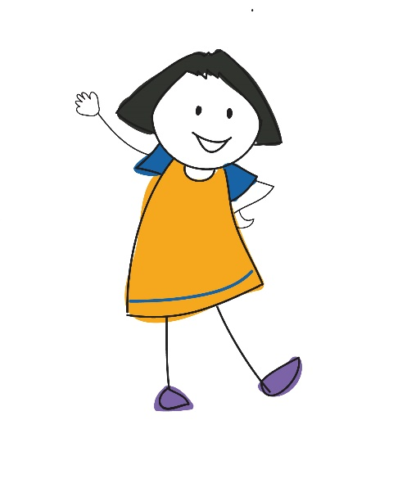
Conclusion
6
What is your general feeling about this training and the seven workshops?
Were your goals met?
Were your goals met?
Would you give this training yourself?
How can it be improved?
What did you like most?
Notes:
Instructions/text for sheet 26
@Trainer: Make a round and collect general feedback about the training and the 7 workshops?

Slide 28
Thank you!

