Slide 1
Project ARMOUR
Preventing youth radicalisation by supporting first line practitioners in boosting resilience in youths
Notes:
Welcome
Indication timeline
Introduction – ARMOUR – Radicalisation 25 min
Coaching & Parenting + exercise 25 min
Break 5 min
Critical Thinking + exercise 25 min
Anger Management + exercise 25 min
Presenting e-learning + flps.com 5 min
Feedback and Conclusion 5 min

Slide 2
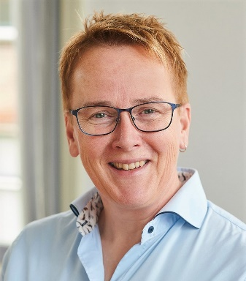
1. Introduction
Euro-Arab Foundation for Higher Studies (Spain)
Center for Security Studies - KEMEA (Greece)
National Intelligence Academy (Romania)
SYNYO GmbH (Austria)
Ministry of Justice (Italy)
Agenfor International Foundation (Italy)
LIBRe Foundation (Bulgaria)
University of Malta (Malta)
University of Groningen (Netherlands)
Valentin Nicula
Carola Onderdelinden

Slide 3
Programme for today
1
Introduction
Project ARMOUR
Radicalisation
Exercises workshops
ARMOUR’s platforms
Feedback and conclusion
Notes:
Goals of this meeting
To present project ARMOUR
To learn about the tools ARMOUR offers (TTT, 7 workshops and e-learning)
To get acquainted with the workshops of project ARMOUR, understanding their content and structure
To experience some exercises (dealing with factors contributing to radicalising youths) from the workshops
To show our tools
Sometimes zoom in to the way a participant would be experiencing a workshop, sometimes zoom out and explain the ideas behind our tools

Slide 4
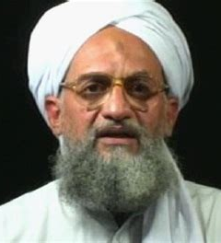
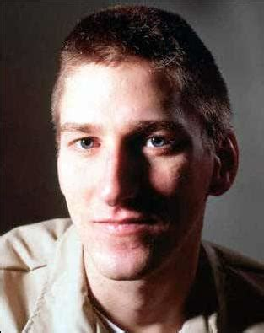
1. Introduction
1
What comes to your mind when you think of ‘a terrorist’?
A
B
C
Ulrike Meinhof, terrorist member of the Rote Armee Fraktion
Ayman al-Zawahiri, terrorist member of Al-Qaida
Timothy McVeigh, terrorist lone wolf
Right
source: www.idrlabs.com
source: www.aawsat.com
source: www.alchetron.com
Notes:
Sources images:
Ulrike Meinhof - https://www.idrlabs.com/enfp.php
Ayman Zawahiri – leider van Al-Qaida (opvolger van Bin Laden) source: www.aawsat.com
Timothy McVeigh – alchetron.com

Slide 5
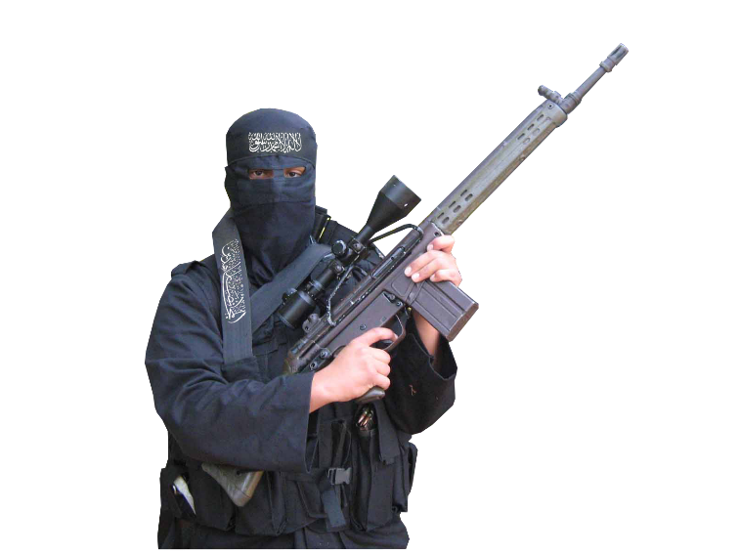
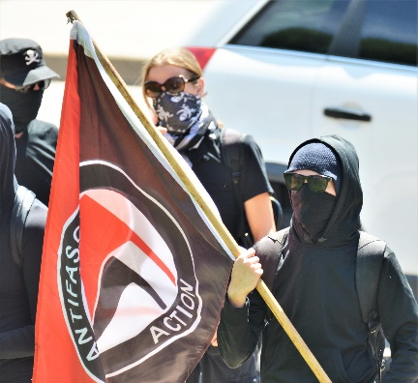
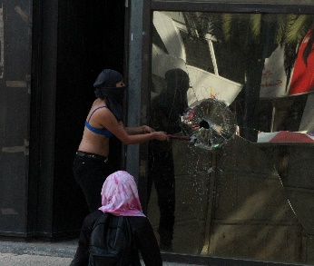
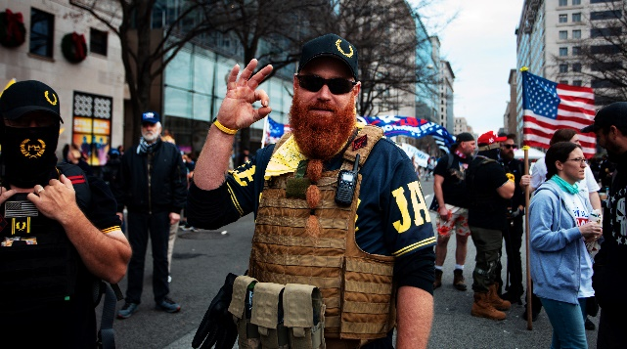
1. Introduction
1
Radicalisation happens across different ideologies
Why?
How?
Right
Left
Religious
Single issue
www.shutterstock.com
www.shutterstock.com
www.hiclipart.com
www.shutterstock.com
Notes:
The first point we stress during the workshops is that radicalisation can happen across different ideologies
Sources images (Via SINYO’s Shutterstock account):
https://www.shutterstock.com/nl/image-photo/washington-dc-usa-dec-12-2020-1873617571 (12 Dec 2020, Proud Boys in Washington)
https://www.shutterstock.com/nl/image-photo/denver-co-usa-june-10-2017-1472772446 Masked Antifa left-wing militants protesting at Trump rally Denver, CO, USA. June 10 2017.
https://www.hiclipart.com/free-transparent-background-png-clipart-ybpcm, Islamic extremist
https://www.shutterstock.com/nl/image-photo/mexico-city-03082020-woman-belonging-radical-1669444774 Mexico City, Mexico, 03/08/2020: woman belonging to a radical feminist group is seen destroying a glass window during the women’s day protest

Slide 6
1.Introduction
1
Note what strikes you
Single issue
Notes:
Some examples
https://www.youtube.com/watch?v=NFrU9egvhbs (3.53m clip from FAST- Families against Stress and Trauma, about British young people who travelled to Syria, unexpected to their families)
(Embed link: <iframe width="560" height="315" src="https://www.youtube.com/embed/NFrU9egvhbs" frameborder="0" allow="accelerometer; autoplay; clipboard-write; encrypted-media; gyroscope; picture-in-picture" allowfullscreen></iframe>)

Slide 7
2. Project ARMOUR
2
Phase 1
Interviews
Phase 2
Focus Groups
Phase 3
Experimental Labs
Products
Train the Trainer
7 Workshops
e-Learning
January 2018
Surveys
Surveys
June 2021
Notes:
No fixed path to radicalisation, but recurring characteristics and factors
Seven of these are being addressed in this project. They were discussed with over 130 first line practitioners in interviews and focus groups. As a result 7 workshops were created and tested in experimental labs.
This was the period COVID-19 hit us all. So we had to convert the Labs and later also the TTT to online courses
We executed Train the Trainer sessions in 6 countries to instruct practitioners on the workshops, we conducted surveys to collect feedback and check for usefulness. Positive feedback
We also created an e-learning

Slide 8
Project ARMOUR (2)
e-Learning
1. What is radicalisation?
5. Evaluation
6. Final test
2. What can I do?
3. Best practices
4. ARMOUR
What does radicalisation look like?
What are possible causes?
History and prevalence
How to boost resilience?
Creating support
Elements of best practices
Selection of best practices
What is project ARMOUR about?
Materials TTT and workshops
Evaluation of preventive practices
Impact assessment project ARMOUR
2
Available on
www.traininghermes.eu
in Dutch, English, German, Greek, Italian, Romanian and Spanish
Notes:
The e-learning
Made up of 6 modules
Available on
I will show more of the e-learning later

Slide 9
2. Project ARMOUR
2
7 workshops
Individual capacity building
Coaching and parenting
Critical thinking
Community capacity building
State response
Anger management
Narratives and identity
Debating and simulation
Conflict management
Proportionate state response
Notes:
The seven workshops
The first three working on individual skills (individual capacity building in the face of adverse conditions),
The second group are about empowering the surroundings of youths (community empowerment and resilience to social polarization, radicalization and violent extremism) and
The last workshop is about effective state response. (moderate and proportionate response of the governmental and security institutions against provocations and latent conflicts)
The idea is that these workshops will be executed by the people that we have trained in the Train the Trainer (TTT) sessions.
Today’s workshop will show you information and examples of 3 of the 7 workshops. You will see that they offer practical, hands-on strategies and personal skills of coaching & parenting, critical thinking, anger management, (make a choice).
We will show you information and examples of exercises of each topic. The basic idea is that after today, you will understand the set-up of the workshops created in project ARMOUR.
Tomorrow’s workshop will highlight the other four topics

Slide 10
2. Project ARMOUR
2
Emotional competence & autonomy building
Social competence
Mediation and negotiation
Problem solving
Key competences
Notes:
The workshops aim to equip first line practitioners with knowledge and tools to help youths become more resilient against radicalisation. Key competences to be strengthened in youths include:
social competence responsiveness to other, conceptual and intellectual flexibility, caring for others, good communication skills, sense of humour
emotional competence & autonomy building positive sense of independence, emerging feelings of efficacy, high self-esteem, impulse control, planning and goal setting, belief in the future
mediation and negotiation group problem solving and consensus, base groups, stop and think before acting to provocation
problem solving ability to apply abstract thinking, ability to engage in reflective thought, critical reasoning skills, ability to develop alternative solutions in frustrating situations

Slide 11
2. Project ARMOUR
2
Knowledge
and hands-on tools
Cognitive-behavioural instructional model and the learning by doing model
Rationale behind workshops
Psycho-educational model of learning
Notes:
This is done by offering knowledge and practical exercises to stimulate resilience
within youths, based on a psycho-educational model of learning
Learning by doing

Slide 12
2. Project ARMOUR
2
Understanding radicalization in general
Relation between radicalisation and specific topic
Clarification specific topic
Exercises
Coaching and parenting
Critical thinking
Anger management
Narratives and identity
Simulation and discussion
Conflict management
Proportionate state response
Set-up
workshops
Understand the topic
Identify problems
Solve problems
Notes:
The set up of each workshop is as follows:
The workshops offer information and exercises to come to:
the internalisation of skills, strategies and techniques to be used with youth. Practiced in the safe environment provided by the workshop.
The workshops propose techniques that help teach young individuals respond to dysfunctional situations that might trigger a radicalisation path. It equips professionals involved in interaction with young people with solutions to encourage them how to control behaviour by making choices that satisfy their needs in non-destructive ways and resolve conflicts in principled ways.
The exercises aim at different results, some teach you how to understand the topics, some to identify/map the problems and some help to solve the problem. Which is why you need to use them in combination for them to be more efficient and not as a one off.
Also, the hands-on strategies and skills taught within the workshops will address both risk factors and protective factors for radicalisation
Every workshop concludes with an evaluation. To improve the execution and make it more relevant.
@Trainer:
The design of monitoring and evaluation systems is fundamental to encourage in-depth thinking and ongoing reflection and ideally learning, about the overall design, approach and strategy of a programme, as well as its suitability to a certain context. Ris, L. and Ernstofer, A. (2017).
Address both risk factors and protective factors for radicalisation.
Every workshop concludes with an evaluation. To improve the execution and make it more relevant.

Slide 13
3. Radicalisation
3
The following definition of radicalisation by the European Commission (2020) is used within this course:
“a phased and complex process in which an individual or a group embraces a radical ideology or belief that accepts, uses or condones violence [ ] to reach a specific political or ideological purpose.”
Notes:
As you saw, each workshop starts with a part about the concept and causes of radicalisation.
From the many definitions around, we chose this definition in ARMOUR
After a short explanation of the main concerns of the major ideologies we continue by addressing different theories
European Commission (2020). Prevention of Radicalisation. Retrieved 27 May 2020 from https://ec.europa.eu/home-affairs/what-we-do/policies/crisis-and-terrorism/radicalisation_en

Slide 14
Phases of Radicalisation
3
In reality people do not follow these phases as distinguishable as on paper
Sensitivity
Exploration
Membership
Action
...applicable to all kinds of radicalisation
Source: Feddes, Nickolson & Doosje (2015)
Notes:
Many theories describe radicalisation as a phased process. One of them is shown in this model that defines 4 phases
Personal characteristics and/or negative experiences can form a breeding ground for radical thinking
Search for identity and meaning. If mainstream society or parents don’t have satisfying answers they might turn to radical ideology and groups
A person is believing radical ideas and starts to spread them, some join a group
Further radicalisation and acceptance of undemocratic means and violence
Feddes, A., Nickolson, L. & B. Doosje (2015). Triggerfactoren in het Radicaliseringsproces. Amsterdam: Universiteit van Amsterdam.

Slide 15
Causal factors of radicalisation
3
Push
Pull
Personal
E.g. a repressive state, relative deprivation, discrimination, anger and injustice
E.g. psychological disorders, personality traits, authoritarian parenting, conflicting identities and traumatic life experiences
E.g. group solidarity, the ideology (propaganda), meaning, adventure, and other rewards
Notes:
Unfortunately, there is no blueprint of the path to radicalisation. No fixed set of factors can be pointed out as ‘the reason why’ people radicalise.
However, several factors were recognised as possible contributing factors. They can be categorised in several ways. Network, needs and narratives is one, but today I would like to show this one.
Push: The structural root causes of terrorism that drive people toward extremist groups and to resorting to violence
Pull: The aspects that make extremist groups and lifestyles appealing to some people, and include, for example, ideology, group belonging, group mechanisms, and other incentives
Personal: More specifically individual characteristics that make certain individuals more vulnerable than their circumstantially comparable peers to radicalization. This includes for example psychological disorders, personality traits, and traumatic life experiences.
In de realiteit zijn push, pull, en persoonlijke factoren nauw met elkaar verbonden

Slide 16
Push, Pull and Personal factors
3
Note examples of push, pull and personal facts
Notes:
If there is enough time: show clip and ask participant to note examples of push, pull and personal factors
https://www.youtube.com/watch?v=kHszRyuR2Ic

Slide 17
4. Exercises workshops
4
7 workshops
Individual capacity building
Coaching and parenting
Critical thinking
Community capacity building
State response
Anger management
Narratives and identity
Debating and simulation
Conflict management
Proportionate state response
Notes:
Now that we’ve seen a sample of the knowledge offered about radicalisation I would like to go back to our workshops. Today we will highlight three of them.
My colleague Valentin will

Slide 18
Workshop Coaching and Parenting
4
Preventing youth radicalisation by effective coaching and parenting
Notes:
Valentin

Slide 19
Adolescence
4
Cognitive
Psychological
Emotional
Social
Biological
Notes:
Child development starts at birth and ends with adolescence. During that time biological, social, emotional, cognitive and psychological changes take place. In each phase a child has a central challenge to overcome. Teenagers and adolescents are on a road from childhood to maturity. Forming their identity along the way.
Background information from D3.1.1
Adolescence is the most challenging life stage for both teenagers and parents, due to the fact that is considered to be a transition phase between childhood and adulthood. During their adolescence, teens experience many changes, from biological, to social, emotional, psychological and cognitive, developing their own identity and struggling to find their place within the society. Given the fact that adolescence is the period when teens begin to argue with their parents when they have different opinions and search to distance themselves from their parents and join different peer groups, the present deliverable aims to identify proper manners and efficient strategies to approach the relationships children-parents, in order to avoid adolescents becoming victims of polarization and radicalization, pushed by tense interactions with their parents. The rationale for using coaching and parenting exercises is motivated by the need to permanently adapt the parenting style to the needs and expectations of teens, who are in continuous changes generated by all societal developments (e. g. access to information, too much information, fake news etc.). Moreover, teaching and parenting strategies allow parents to better understand their children’s behaviour, decisions and reactions, enabling them to prevent their teens from becoming an active part of the radicalization/polarization process, as a consequence of different social problems unidentified or treated in the wrong manner.

Slide 20
3. Adolescence and radicalisation
4
Who am I?
Where do I belong?
Triggers for
Radicalisation
search for identity
personal fulfilment
lack of self-esteem
individual frustration and insult
What is my role on this earth?
Do I matter? How do I contribute?
Am I good enough?
How to cope with adversity?
How does a relationship work?
How do others see me?
Notes:
The questions that young people ask themselves, consciously or unconsciously, during adolescence are as follows:
If you put these questions alongside a number of common triggers, you will understand why adolescence is a vulnerable period when it comes to the risks of radicalisation.
The way adolescents are supported during this period can help them grow into balanced and mature young adults. It may also be that triggers for radicalisation develop during this journey to adulthood.

Slide 21
3. Coaching and Parenting
4
Tasks parents / coaches
Facilitate positive identity formation Give positive reinforcement Set boundaries Stimulate personal growth
Skills youth
Managing emotions
Develop empathy
Develop team skills
Recognise stereotyping
Notes:
In order to create reliance in youths, the main goals parents and coaches have in this stage of development are to make positive identity formation possible, offering positive reinforcement, setting boundaries and stimulating personal growth.
To create resilience against radicalisation, the main skills teenagers must address during their emotional and behavioural development process, in which parents and mentors/coachers play in important part, are as follows: Recognizing and managing emotions, Developing empathy, Developing teamwork skills and to Recognize, avoid stereotyping and stop discriminating people
Coaching and parenting might offer the right tools to consolidate resilience and positive identity formation.
Counselling and family pedagogy are two psychoeducational models of intervention relatively new, which aim to provide, both to the wards and to parents, understanding and the right psychological and emotional tools to support themselves/their children by providing them with the ability to manage emotions, appreciate differentiation, work with positive reinforcement, manage stress situations, include social support,
@Trainer – background
Coaching and parenting techniques are two essential instruments that play an important role in the development process of adolescents’ identity formation and behavioural reinforcement. Using coaching and parenting in addressing personal growth and children development is not a form of psychotherapy. It is however a form of psychoeducational intervention, in which the role-model, mentor, coacher, or parent becomes skilled in facilitating identity differentiation, positive reinforcement and personal growth in the mentee, student, child. This form of intervention creates premises for improving relational frameworks and generating positive behavioural change, while offering a safe space to exercise skills and techniques.
The main skills teenagers must address during their emotional and behavioural development process, in which parents and mentors/coachers play in important part, are as follows (D3.2.1):
Recognizing and managing emotions - in order to be able to manage any difficult situation that may appear, teens need to first develop their ability to identify the source of their feelings, to be able to label properly the problem. When feelings are not labelled in a proper manner, they might become a source of violence or bad behaviour, adolescents seeking to manage their emotions in unconstructive ways, because they do not know the source (Goleman, 1994);
Developing empathy – after learning how to correctly label their feelings, teens need to develop their ability to understand the emotions of those around them, and most important, they need to learn to take those feelings into account when communicating/interacting. Therefore, empathy can be taught in different ways, from helping adolescents to empathize with different cultural and religious groups (avoid discriminating attitudes), to understating what are the consequences of prejudice and assumptions (Aronson, 2000);
Developing teamwork skills – in nowadays society, the ability to cooperate and work together with others in order to achieve a common or personal goal is the key to survival – even a video game requires having to cooperate with other players in order to reach next level. In the same manner, in real life, working together with others plays an important role not only in establishing interactions and connections, but also in working for a common good (Santrock, 2001);
Recognize, avoid and stop stereotyping and discriminating people - after learning how to control and express their feelings towards themselves and towards others, teens need to develop their understanding of what is a stereotype and how can it affect the relationship with their peers. Moreover, adolescence is the most challenging life stage in terms of stereotypes impact on young people (e.g. gender stereotypes, sexual bullying etc.).
How can parents and practitioners help youths to develop these skills?
De belangrijkste doelen die ouders en coaches in deze ontwikkelingsfase hebben, zijn het mogelijk maken van positieve identiteitsvorming, het bieden van positieve bekrachtiging en het stimuleren van persoonlijke groei.
De belangrijkste vaardigheden waaraan adolescenten tijdens deze fase aandacht moeten besteden om tot evenwichtige, weerbare en sociale volwassenen uit te groeien, en waarbij ouders en mentoren/begeleiders een belangrijke rol spelen, zijn de volgende: emoties herkennen en beheersen, empathie ontwikkelen, teamworkvaardigheden ontwikkelen en stereotypering en discriminatie van mensen herkennen, en bijsturen.
Coaching en ouderschap kunnen de juiste instrumenten bieden om veerkracht en positieve identiteitsvorming te consolideren.
@trainer – background information
Recognizing and managing emotions - in order to be able to manage any difficult situation that may appear, teens need to first develop their ability to identify the source of their feelings, to be able to label properly the problem. When feelings are not labelled in a proper manner, they might become a source of violence or bad behaviour, adolescents seeking to manage their emotions in unconstructive ways, because they do not know the source (Goleman, 1994);
Developing empathy – after learning how to correctly label their feelings, teens need to develop their ability to understand the emotions of those around them, and most important, they need to learn to take those feelings into account when communicating/interacting. Therefore, empathy can be taught in different ways, from helping adolescents to empathize with different cultural and religious groups (avoid discriminating attitudes), to understating what are the consequences of prejudice and assumptions (Aronson, 2000);
Developing teamwork skills – in nowadays society, the ability to cooperate and work together with others in order to achieve a common or personal goal is the key to survival – even a video game requires having to cooperate with other players in order to reach next level. In the same manner, in real life, working together with others plays an important role not only in establishing interactions and connections, but also in working for a common good (Santrock, 2001);
Recognize, and stop discriminating people - after learning how to control and express their feelings towards themselves and towards others, teens need to develop their understanding of what is a stereotype and how can it affect the relationship with their peers. Moreover, adolescence is the most challenging life stage in terms of stereotypes impact on young people (e.g. gender stereotypes, sexual bullying etc.).
How can parents and practitioners help youths to develop these skills?

Slide 22
Coaching and parenting: exercise
4
Present your role model
Most influential person in your life
How would your role model help counter these drawbacks
Describe why
Three major drawbacks for youths today
Note three characteristics
Notes:
How can parents and practitioners be supported to help youths to develop these skills?
This is an example of one of the exercises in the workshop Coaching and Parenting. Please take a paper and pen (or tablet/smartphone/laptop). My suggestion is to first experience how the exercise goes and then discuss the objectives
@Trainer
This exercise takes about 15-20 min (??)
Step 1: The trainer will ask each participant to think about a person that influenced them most in a positive way and write down the main features of that person, as well as their motivation to consider that person the most influential one in their lives.
Step 2: Participants will be asked to think about three major drawbacks to the personal development of young people today and list them.
Step 3: Participants will be asked to think about and describe the way in which their model figure can help them minimize the effects of the drawbacks.
Step 4: Participants will be asked to think about and note down another 3 characteristics they consider a role model should possess (other than the ones already identified in connection with the person described).
Note: for those participants who do not know how to write, the moderator will create a small working group to discuss the above-mentioned points.
Step 5: The trainer will invite each participant to present their role model in front of the group, and to tell how this can help in working with youths, engaging all the participant to comment and discuss. [Online: make break-out rooms and let participants share their role models (give them 5 minutes to discuss) and on return ask a few duos what they discussed]

Slide 23
Coaching and parenting: Exercise
4
Build your own role model
objective
instructions
target audience
duration
Notes:
The exercise is named Build your own role model
Ask participants: What do you think about the idea behind this exercise?
The objective is to let parents and coaches think about the positive influences they have experienced in their lives and translate that to being a positive role model for their children / pupils
Each workshop comes with a manual that describes the objective, target audience and timing of each exercise. Also instructions are given about the execution and materials needed for the exercise.
Objective
In the process of personal development experienced during adolescence, young people tend to copy in actions and behaviour the person they most appreciate (a parent, family relative, older friend, superhero, movie star etc.). These exercises will help participants build their own role model starting from the person they consider most influential in their lives and translate that to being a positive role model themselves
Target audience
Puberty/teenage and parents
After the break, Valentin Nicula will share samples of the workshop about critical thinking

Slide 24
Project ARMOUR
5 minute break
This project was funded by the European Union’s Internal Security Fund — Police, under Grant Agreement No. 823683.
Notes:
Restart preferably at the hour, max after 1.05

Slide 25
Critical Thinking
4
Preventing youth radicalisation by teaching youths critical thinking skills
Notes:
Valentin
The next topic is critical thinking. Lack of it is considered to be a risk factor for radicalisation.

Slide 26
Critical thinking
4
Critical thinking
Deliberately analysing information
based on facts
to make better judgment and decisions
Apply to polarising messages like:
Binary, us-them, black and white propaganda
Fake news
Biased reporting
Notes:
@trainer:
There is a clip behind the picture, depending on time we could show it or skip it
@trainer, background
The most fundamental definition of thinking is very simple and intuitive: all humans think. But critical thinking begins when we start thinking about our thinking with a view toward improving it (Paul & Elder, Critical Thinking. Tools for Taking Charge of Your Professional and Personal Life, 2014, p. 6).
Critical thinking can be seen as having two components:
a set of “information and belief generating and processing” skills, and
the habit, based on intellectual commitment, of using those skills to guide behaviour.
It is thus to be contrasted with:
the mere acquisition and retention of information alone, because it involves a particular way in which information is sought and treated;
the mere possession of a set of skills, because it involves the continual use of them; and
the mere use of those skills (“as an exercise”) without acceptance of their results.
Ask participants: In what way is critical thinking significant in the process of radicalisation? Discuss in twos
Then click for second text block
@trainer, background
By being taught how to think critically, we learn how to pursue “truth” over our own biases, persist through challenges, assess our own thinking fairly, and abandon mistaken reasoning for new and more valid ways of thinking.
Why is critical thinking important when addressing societal polarization caused by the adoption and spread of extremist ideologies? Because it empowers young people to think independently, to make sense of the world based on personal experience and observation, and to make critical well-informed decisions in the same way. As such, they gain confidence and the ability to learn from mistakes as they build successful and productive lives.
Thinking or reasoning involves objectively connecting present beliefs with evidence in order to believe something else. By comparison, critical thinking is a deliberate meta-cognitive (thinking about thinking) and cognitive (thinking) act whereby a person reflects on the quality of the reasoning process simultaneously while reasoning to a conclusion. The thinker has two equally important goals: coming to a solution and improving the way she or he reasons (Moore, 2007, p. 2).
Why is critical thinking so important? From https://www.radicalrightanalysis.com/2018/07/26/uk-prevent-building-resilience-to-radicalisation-through-critical-thinki/
1 - because extremists thrive on propagating a binary, black and white view of the world, encouraging a “them against us” mentality. Most of the high-risk Prevent referrals I have dealt with were attracted by the certainty of clear extremist narratives that left no room for nuance or doubt. From the 15 year old white supremacist who believed that Muslims wanted to kill westerners and that a race war was on the horizon, to the young convert to Islam who believed that Muslims were not welcome in the UK and so the only place he could freely practice his faith was in the so-called caliphate of the Islamic State.
2 - our social media platforms are awash with so-called ‘fake news’ and propaganda and if children are to be well informed and safe it is important to question the source of nearly everything they see online. From seemingly innocuous rumours about celebrities to malevolent attempts by extremist groups to spread fear or recruit vulnerable people, careful consideration is required to avoid falling prey to emotional manipulation. The pull factor of ideologies and manipulative or false information
3 - Added to this is the damage to integration and community cohesion that can result from a lack of critical thinking in reporting, even within the mainstream media. Consider the language used when national newspapers cover terrorist attacks. How quickly are Muslim offenders labelled terrorists and their crimes linked to faith by some outlets? Meanwhile, a more nuanced view is sometimes taken when attackers are non-Muslim.

Slide 27
Critical thinking: Exercise #1
4
Report conclusions to greater group
Everybody writes one sentence on ‘hate’
Reflect
Break out in groups
Discuss
Read your sentences one by one
Notes:
This is an example of one of the exercises in the workshop Critical thinking. My suggestion is to first experience how the exercise goes and then discuss the objectives, therefore you will first need a piece of paper (per group).
@Trainer
When the session is executed on line, this exercise needs adjustment: ask everybody to write one sentence on ‘hate’ on a piece of paper. At your signal ask all participants to copy that sentence on the digital whiteboard (or similar central boards). Ask participants to reflect on what they see OR make break out rooms in which they read out their sentences
This exercise takes about 20 minutes. You can swap the topic to your liking (hate/ government/ discrimination/ refugees/ corona/ …)
After writing:
The goal is for participants to understand how each participant adds his/her own vision on the topic and how their perspectives vary.
Additionally, they learn to apply their knowledge and logic to explaining themselves as clearly as possible.
At the end, the trainer collects the writings and present to the group the definitions, explaining the importance of having different perspectives when addressing a problem.
Step 1: form groups of 6-8 participants. One piece of paper per group
Step 2: ask the first participant from each group to write one sentence describing on a piece of paper what hate is to him or her.
Step 3: the participant folds the paper down to cover the sentence received. Now only their sentence is visible and no other, so each time they pass students can see one sentence. The first participant then passes the paper to the second one who adds her/his sentence that illustrates the understanding of the topic also in a single sentence.
Step 4: repeat folding and passing until every person in the group has written down a sentence
Step 5: 1st person unfolds the paper and reads all definitions aloud. Discuss what strikes you
Step 6: report group conclusion to the central group
@trainer
At the end explain the importance of having different perspectives when addressing a problem.
Ask how this can help in working with youths, engaging all the participant to comment and discuss.
It is important to note that analysing a problem from different perspectives is helpful in finding the best way to solve it and reducing uncertainty.
Also, by acknowledging the fact that humans have different perspectives, the trainer reinforce the notion of tolerance and acceptance of diversity.

Slide 28
Critical thinking: Exercise #1
4
Try one sentence
objective
instructions
target audience
duration
Notes:
This exercise is named Try one sentence
Ask participants: What do you think about the idea behind this exercise?
The objective is to understand the impact of different perspectives on the same topic
Background trainer:
Objective
“One of the many ways in which our mind attempts to make life easier is to solve the first impression of the problem that it encounters. Like our first impressions of people, our initial perspective on problems and situations are apt to be narrow and superficial. We see no more than we’ve been conditioned to see — and stereotyped notions block clear vision and crowd out imagination. This happens without any alarms sounding, so we never realize it is occurring”. This exercise shows that many perspectives of the same topic exist.
Target audience
Age groups - teenage/adult
Timing
30 minutes
Input
White paper, pens, markers
Learning method
Learning by doing, demonstration and guided discussion

Slide 29
Critical thinking: Exercise #2
4
Make pairs
Choose article
Answer the 6 questions
Trustworthy?
Six critical questions, Copyright 2009, Critical Thinking Asylum,
access at: https://www.flickr.com/photos/criticalthinkingasylum/3722280574#.
Notes:
There are many types of exercises that can be developed in order to train the critical thinking kills, but probably one of the most popular is the 6 critical questions. My suggestion is to first experience how the exercise goes and then discuss the objectives, therefore please take your laptop (or tablet/smartphone).
@Trainer
This exercise takes about 45 minutes
Step 1: The trainer divides the group in pairs. [on-line break-out sessions can be organised with certain platforms]
Step 2: Then ask them to choose an article related to a recent event or development in your local language (e.g. immigration, global warming or development of technology like internet of things, artificial intelligence) and present it to the audience. (Or choose to provide articles, this saves time)
Step 3: the trainer asks each team to provide answers to all 6 questions in the order presented in the infographic below. Distribute handouts
Step 4: In the end, the trainer asks each group to decide if the article can be trustworthy or not, based on the answers provided to the guiding questions, stressing the importance of questions for the critical thinking process.

Slide 30
Critical thinking: Exercise #2
4
The 6 questions
objective
instructions
target audience
duration
Notes:
As I have already said, this exercise is named The six questions
Ask participants: What do you think about the idea behind this exercise?
The objective is to understand the role of questions for critical thinking
Each workshop comes with a manual that describes the objective, target audience and timing of each exercise. Also instructions are given about the execution and materials needed for the exercise.
The six questions
Objective
Understanding the role of questions for critical thinking
Target audience
Age groups - teenage/adult
Timing
45 minutes
Input
Internet access for research and documentation, white paper, flipchart, and markers
Learning method
Demonstration, feedback
Visual support
Printed graphic representing the 6 questions

Slide 31
Workshop Anger Management
4
Preventing youth radicalisation by teaching them anger management
Notes:
Carola
Learning to manage anger properly is a skill, it does not come by instinct. It is related to how we place a threshold to a complex interplay with other emotions.

Slide 32
Anger Management: exercise
4
How do I know that I am angry?
Which events/people/places/things make me angry?
How do I react when I'm angry?
How does my angry reaction affect others?
source: emojiisland.com
Discuss in twos
Notes:
an example of one of the exercises in the workshop Anger Management. Please take a pen and paper (or tablet/smartphone/laptop).
#1 Brainstorming – free associations Icebreaker 1 (15-20 min)
@Trainer
This exercise is one of the icebreakers in the workshop on Anger Management. It takes about 15-20 minutes
Step 1-4: Trainer asks participants to answer the following questions (one by one) by writing no more than three words per question on a sheet of paper. (4 min)
Step 5: each participant chooses a partner and shares answers with him/her. (5 min) (online: two people per break out room)
Step 6: a 2 minutes roundup discussion is used by the trainer to collect possible answers on a flipchart. Hopefully, the observations of the participants point to the objective of this exercises: to become aware of one’s personal way of experiencing and dealing with anger, and to be able to recognise it. People become aware that anger is something we are all familiar with.
Trainer closes the ice breaker by pointing at the most common answers
Background:
If fitting, trainer can add that anger is often experienced as a physical reaction to (the interpretation of) the situation.
These are examples of visible signs of it:
Physical tension
Jaw clenching or teeth grinding
Intense speech or behaviour
Whining or shouting
Restlessness or withdrawal
Pouting
Frowning eyebrows
Rolling of the eyes
...

Slide 33
Anger
‘Try to understand why they are angry, and try to challenge this anger.’
Source: terratoolkit.eu
Notes:
https://vimeo.com/113623893
@Trainer
Clip to illustrate the connection between anger and radicalisation (show 9.46-12.42 min)

Slide 34
Anger
4
Insecurity
Experienced injustice
Anger
Radicalisation
Insufficient self correction of impulses
Source: Van den Bos, 2019)
Notes:
A few notions about anger
One of the causal factors that has been examined by researchers is experienced injustice, like unfair treatment, relative deprivation, immorality etc.
This can become a push factor to radicalisation, especially when people feel insecure, or are not able to control certain emotions.
P19 Kees van den Bos (2019)
The anger pushes them away from mainstream society, because it causes a negative association.

Slide 35
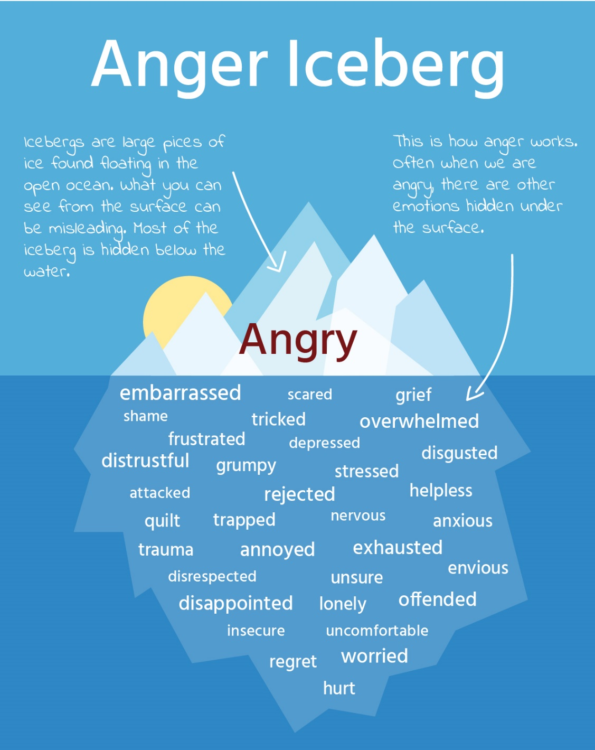
Anger
4
Primary and secondary emotion
Short lived or chronic
Source: LIBRe based on https://www.gottman.com
Notes:
When people are angry it is often not the only emotion in play.
Anger as second-hand emotion
Anger can be a fundamental and primary emotion, but is also often called a secondary emotion because we tend to resort to anger in order to protect ourselves from or cover up other vulnerable feelings. A primary feeling is what is felt immediately before we feel anger. We almost always feel something else first before we get angry. We might first feel afraid, attacked, offended, disrespected, forced, trapped, or pressured. If any of these feelings are intense enough, we think of the emotion as anger.
As the drawing illustrates, anger is like an iceberg in that only some of the emotions are visible. The other emotions exist "below the water line" where they are not immediately obvious to outside observers. (http://creducation.net/resources/anger_management/anger__a_secondary_emotion.html)
Why do you think this could be relevant in this context?

Slide 36
Anger
4
Natural and automatic response
Fundamental yet often secondary emotion
Push factor
Managing it is a skill
Direct vs chronical
Notes:
Concluding, anger
is considered a natural and mostly automatic response to adverse acts
Anger is a fundamental emotion. And it often takes the place of an underlying emotion. Some people feel it is a ‘bad’ or negative emotion, others say it only becomes a problem when someone is holding on to anger and it becomes chronical.
As explained before, anger is a push factor towards radicalisation
together with a sense of identity /‘quest for significance’, individual frustration and insult, cognitive-social factors like risk taking and reduced social contact, personal victimization, displacement of aggression
Learning to manage anger properly is a skill, it does not come by instinct. It is related to how we place a threshold to a complex interplay with other emotions.
People who are incapable of getting angry are also incapable of standing up for themselves. It is important then that people learn how to express anger appropriately.
People need to learn healthy and socially respectful ways to express angry feelings, and to not to let anger get out of control to the point where it negatively affects relationships, employability and health.
It is more satisfying to feel angry than to acknowledge the painful feelings associated with vulnerability.

Slide 37
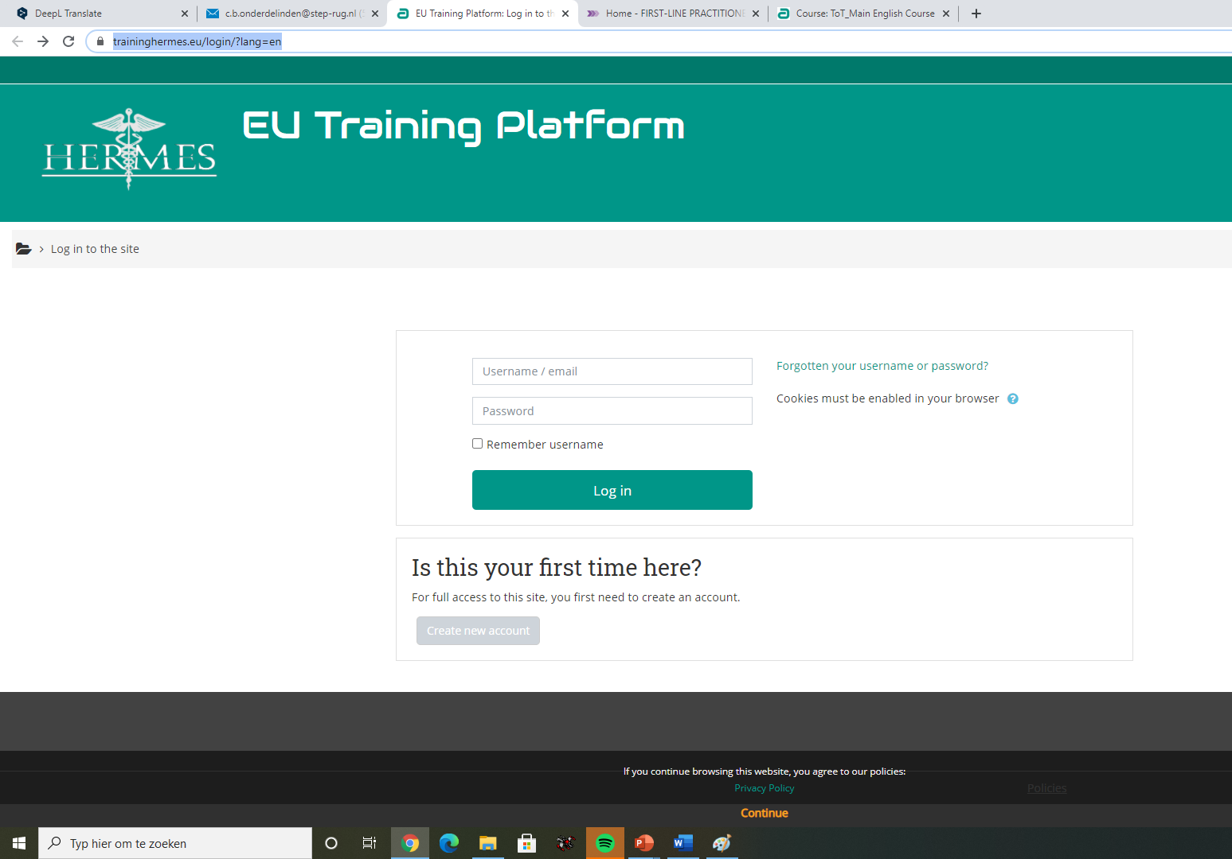
5. ARMOUR’s Platforms
5
Presenting all materials for the Train the Trainer course and the 7 workshops. Available in English from today. Other languages will follow
Presenting the e-learning, including all materials for the Train the Trainer course and the 7 workshops. Available in seven languages by 1 July 2021
Dutch, English, German, Greek, Italian, Romanian and Spanish
Notes:
Our materials will be presented on two platforms
@trainer: click on images
https://www.firstlinepractitioners.com/
Go to the website and show where exactly, also point out the evaluation materials
Additional information and training can be found on the EU training platform Hermes
https://www.traininghermes.eu/
Go to the website, explain how they can register and show our e-learning (make sure you have an account so you can access the course)

Slide 38
6. Feedback
What interested you most?
FEED
BACK
Notes:
Exercises
Coaching and parenting Make your own role model
Critical thinking Try one sentence
Anger Management How do you know you’re angry?

Slide 39
Thank you!

