Slide 1
"Strengthening a comprehensive approach to preventing and counteracting radicalisation based on a universal evidence-based model for evaluation of radicalisation prevention and mitigation”
European Conference on Preventing Polarisation & Violent Radicalisation Session: Getting Better at Getting Better: Evaluation, Learning Lessons and Improving Policy and Practice in the EU
Dr. Marzena Kordaczuk-Was
Polish Platform for Homeland Security, Coordinator of INDEED Project
28 April 2021
This project is funded under the European Union’s Horizon 2020 – Research and Innovation Framework Programme H2020-SU-SEC-2020, under grant agreement no.101021701

Slide 2
INDEED – General information
Tittle: Strengthening a comprehensive approach to preventing and counteracting radicalisation based on a universal evIdeNce-based moDEl for Evaluation of raDicalisation prevention and mitigation
Call: H2020-SU-SEC-2018-2019-2020 (Security); Topic: SU-FCT01-2018-2019-2020; sub-topic: Developing evidence-based approaches to evaluate and to further develop initiatives to prevent and counter violent radicalisation
Type of action: RIA
Duration in months: 36
Start & end of the project: September 2021 to August 2024
Current phase: Grant Management (GA signed by the Cooridnator and EC)
Total Budget: 498.3330,00 EUR
This project is funded under the European Union’s Horizon 2020 – Research and Innovation Framework Programme H2020-SU-SEC-2020, under grant agreement no.101021701

Slide 3
INDEED’s aim
The main aim of the INDEED project is to use evidence-based approaches to strengthen first-line practitioners’ and policy makers’ knowledge, capabilities and skills for designing, planning, implementing and evaluating PVE/ CVE / and De-radicalisation initiatives, such as policies and strategies, long-term programmes, short-term actions and ad- hoc interventions, in an effective and proven manner.
This project is funded under the European Union’s Horizon 2020 – Research and Innovation Framework Programme H2020-SU-SEC-2020, under grant agreement no.101021701

Slide 4
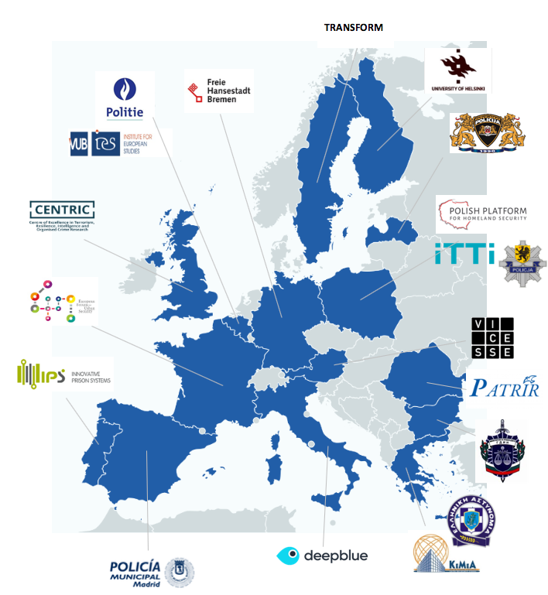
INDEED Consortium
No of partners: 19
Countries: 15
Interdisciplinary Consortium:
6 NGOs
3 Universities
1 RTO
2 SME
7 Practitioners (including 5 LEA & 2 public authorities)
COORDINATOR
This project is funded under the European Union’s Horizon 2020 – Research and Innovation Framework Programme H2020-SU-SEC-2020, under grant agreement no.101021701

Slide 5
INDEED’s objectives
To develop a co-created evidence-based approach to the evaluation of PVE / CVE and De-radicalisation initiatives (Evidence Based Evaluation Model – EBEM for radicalisation prevention and mitigation).
To foster capacity building, knowledge transfer and skills development in the evaluation of PVE / CVE and De-radicalisation initiatives (EBEM-based Evaluation Tool; trainings; Toolkit with e-learning suite).
To contribute to increasing the sense of security among EU citizens by improving the effectiveness of policies and security measures in the area of PVE / CVE / De-radicalisation (enriching the current policy recommendation sin the filed of evaluation).
To increase the visibility of INDEED outcomes and facilitate processes for their broad use, exploitation and sustainability.
To ensure ethics-centred evaluation and design, enshrining gender mainstream, fundamental rights standards, and societal desirability at the core of PVE / CVE / De-radicalisation initiatives.
This project is funded under the European Union’s Horizon 2020 – Research and Innovation Framework Programme H2020-SU-SEC-2020, under grant agreement no.101021701

Slide 6
INDEED’s work package breakdown
+ WP9 ETHICS
This project is funded under the European Union’s Horizon 2020 – Research and Innovation Framework Programme H2020-SU-SEC-2020, under grant agreement no.101021701

Slide 7
INDEED’s Toolkit
This project is funded under the European Union’s Horizon 2020 – Research and Innovation Framework Programme H2020-SU-SEC-2020, under grant agreement no.101021701

Slide 8
Why INDEED?
Solid scientific and empirical basis for the development of an evidence-based approach to the evaluation and design of PVE/CVE and De-radicalisation initiatives such as policies and strategies, long-term programmes, short-term actions and ad-hoc interventions.
Comparison and combination of research and methodological approaches to evidence-based evaluation in the PVE/ CVE /De-radicalisation area with the other crime prevention areas.
Focusing on the entire process of designing, planning, implementation, evaluation and utilization of results of preventive and countering measures.
Building upon completed and an ongoing EU-funded projects.
Identifying evidence-based results from previous successes and lessons learned from failed initiatives.
Providing an interactive Evaluation Tool based on a scientific Evidence-based Evaluation Model (EBEM) for radicalisation prevention and mitigation.
Providing evidence-based evaluation for initiatives implemented in the area of PVE/CVE and De-radicalisation that have not been assessed yet.
Development of SMART (Stakeholder Multisectoral Anti-Radicalisation Team) Hubs guided by a co-design philosophy and grounded in a geographical and sectorial dimension.
This project is funded under the European Union’s Horizon 2020 – Research and Innovation Framework Programme H2020-SU-SEC-2020, under grant agreement no.101021701

Slide 9
Thank you for LISTENING
Marzena Kordaczuk-Was
Coordinator of INDEED Project
Polish Platform for Homeland Security
e-mail: marzena.kordaczuk@ppbw.pl
tel. + 48 61 663 02 21
www.ppbw.pl/en
@PolishPlatform
This project is funded under the European Union’s Horizon 2020 – Research and Innovation Framework Programme H2020-SU-SEC-2020, under grant agreement no.101021701

