Slide 1
Meeting the Challenges of Extremism in Europe Today:
Lessons of the Last Decade, Opportunities to Intervene & The Road Ahead
Luca Gervasoni - Director of Novact and OPEV founder - @gervasonivila

Slide 2
Index of contents
Who we are & origin of the data
Trends& Evolution of violent extremism in Europe
Last decade trends in PVE/CVE policies
Opportunities and Road Ahead

Slide 3
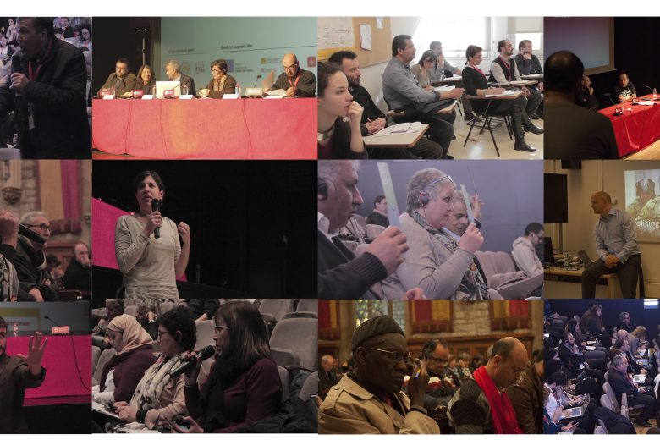
Who we are & origin of the data
Rap & OPEV
Global Terrorism Index 2020 of the IEP - GTD
The globalisation of CVE policies, by TNI
“Resentment and Redemption: On the Mobilization of Dominant Group Victimhood,” by St. Andrews.
Engaging women in countering violent extremism: avoiding instrumentalisation and furthering agency, by Sophie Giscard d’Estaing

Slide 4
Trends& Evolution of violent extremism in Europe
Global overall fall of deaths
Fall of ISIL-related terrorism deaths since 2014 pick
Political violence is more relevant today than religious violence is Europe
Far-right incidents have increased 250 per cent over the past 5 years
Political violence is more publicly acceptable
New trend: Dominant group victimhood
Human Rights deteriorated markedly. #Trend: Forced deportations

Slide 5
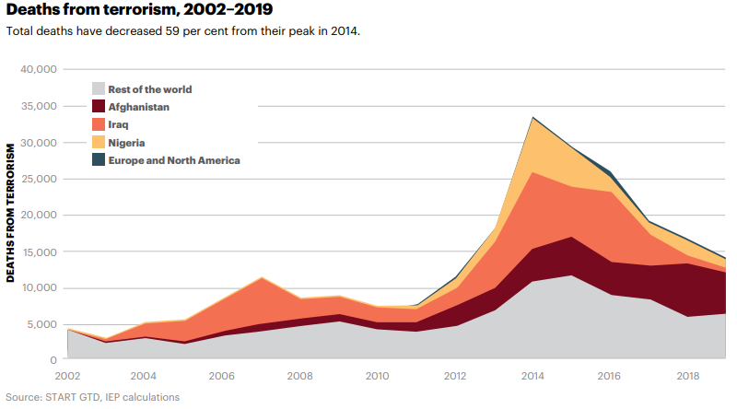
2. Trends& Evolution of violent extremism in Europe
#GlobalFramework

Slide 6
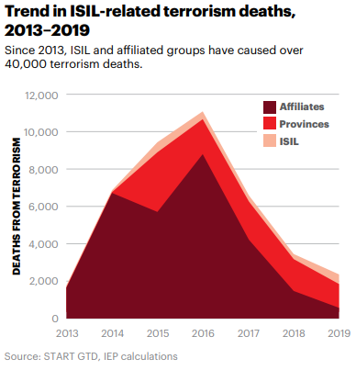
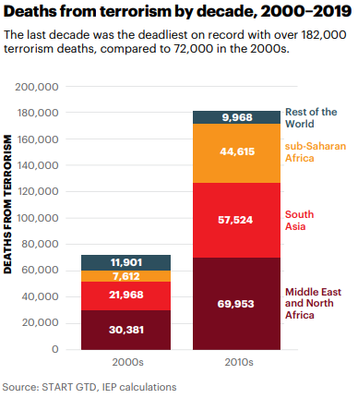
2. Trends& Evolution of violent extremism in Europe
#GlobalFramework

Slide 7
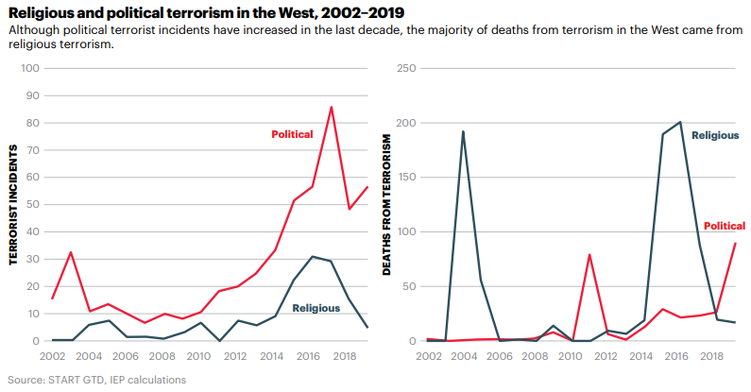
2. Trends& Evolution of violent extremism in Europe
#ReligiousVsPolitical Violence

Slide 8
2. Trends& Evolution of violent extremism in Europe
#Shrinking space for civil society and HRD in Europe

Slide 9
2. Trends& Evolution of violent extremism in Europe
#Trend: Mobilization of Dominant Group Victimhood

Slide 10
3. Last decade trends in PVE/CVE policies in Europe
Increase of PVE/CVE interventions
At international level: main focus DAESH. Authoritarianism
P/CVE projects in Europe span eight themes: development of education; media awareness; empowerment of women; youth work; socioeconomic inclusion; governance capacity building; transitional justice; and inter-communal activities including sport and inter-faith dialogue
Main concerns identified
For the communities without the communities
Vague definitions Vs Strong investment
Empirical incoherence Vs main focus is ideology
Expanding peace actors Vs Securitizing more spaces

Slide 11
4. Opportunities and Road Ahead
Artificial intelligence: Opportunity or threat?
NAP’s for and with communities?
Do no Harm / Conflict sensitivity / Gender and Human Rights focus on all interventions: we are eroding TRUST!

